Slide 1

Chapter 2. Basic data structures
Nguyễn Khánh Phương
Computer Science department
School of Information and Communication technology
E-mail: phuongnk@soict.hust.edu.vn

Slide 2
Contents
2.1. Array
2.2. Record
2.3. Linked List
2.4. Stack
2.5. Queue

Slide 3
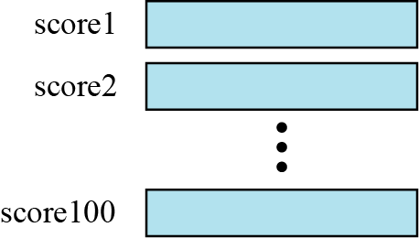
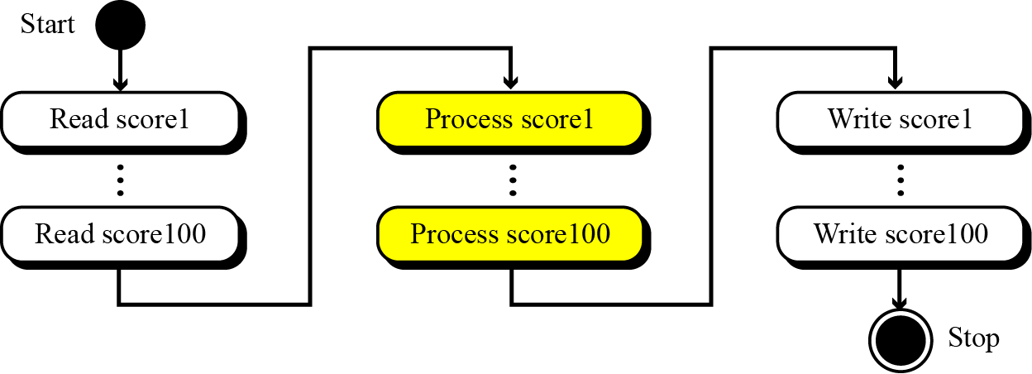
2.1. Array
Imagine that we have 100 scores. We need to read them, process them and print them. We must also keep these 100 scores in memory for the duration of the program. We can define a hundred variables, each with a different name, as shown in Figure1.
But having 100 different names creates other problems. We need 100 references to read them, 100 references to process them and 100 references to write them. Figure 2 shows a diagram that illustrates this problem.
Figure 1 A hundred individual variables
Figure 2 Processing individual variables

Slide 4
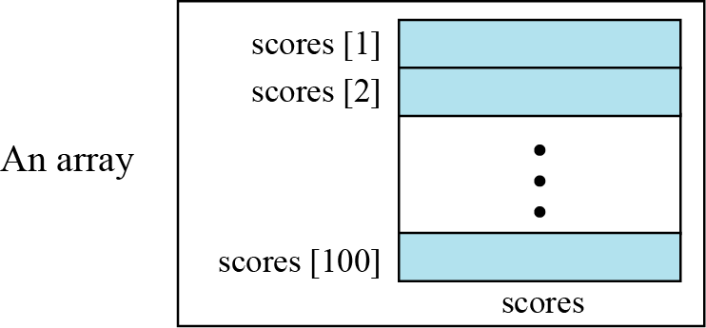
2.1. Array
An array is a sequenced of elements, normally of the same data type, although some programming languages accept arrays in which elements are of different types.
We can refer to the elements in the array as the first element, the second element and so forth, until we get to the last element.
Figure 3. Arrays with indexes

Slide 5
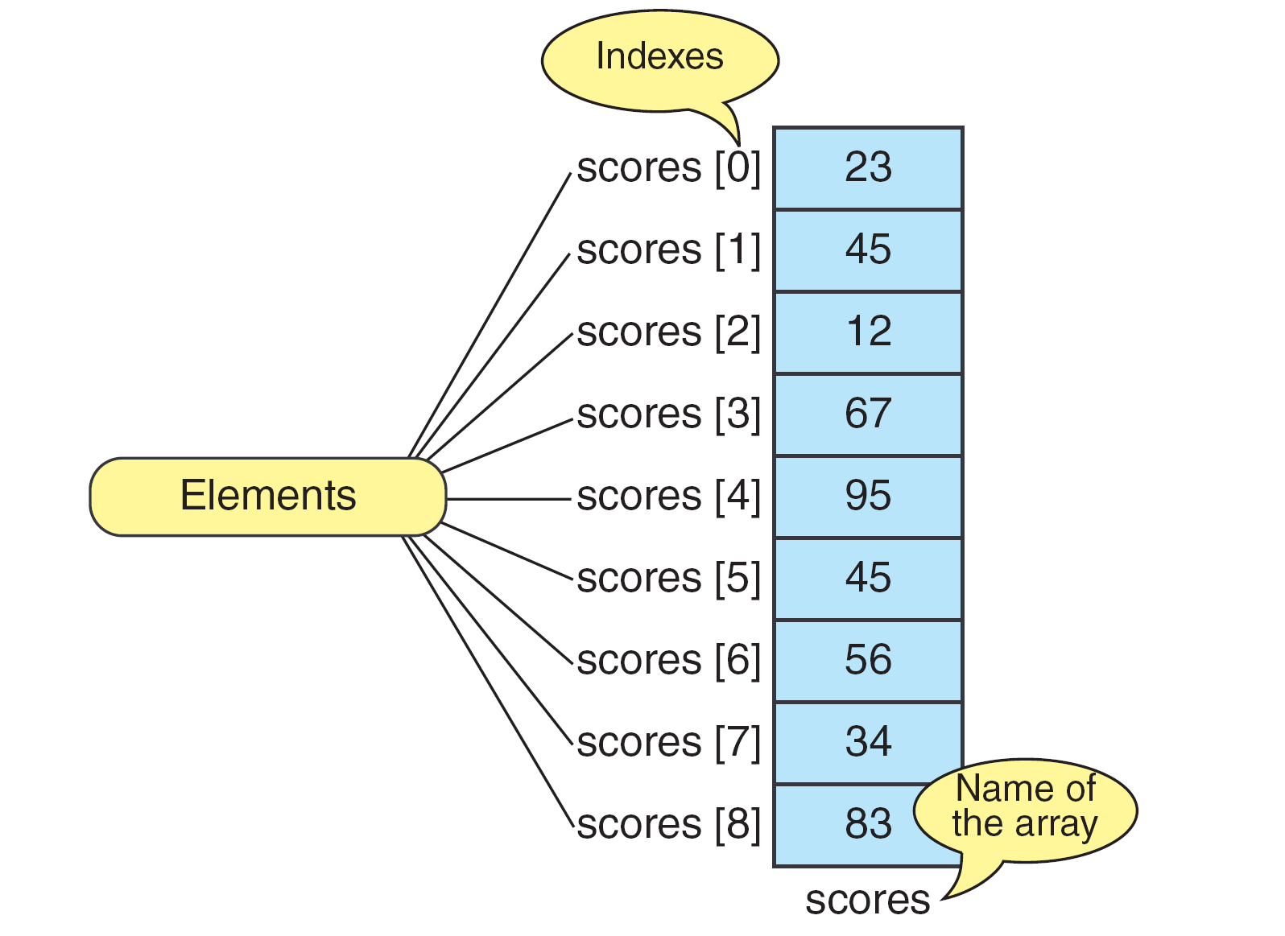
2.1. Array
Basic definitions
An array is a fixed size sequential collection of elements of identical types.
Array: a set of pairs (index and value)
data structure: for each index, there is a value associated with that index.
representation: implemented by using consecutive memory.
In C/C++/Java: the element in an array are indexed by the integers 0 to n- 1, where n is the size of the array

Slide 6
Array name versus element name
In an array we have two types of identifiers:
the name of the array
the name of each individual element.
The name of the array is the name of the whole structure, while the name of an element allows us to refer to that element.
Example:
the name of the array is scores, and name of each element is the name of the array followed by the index, for example, scores[0], scores[1], and so on.

Slide 7
Array types in C
C supports two types of arrays:
Fixed Length Arrays : The programmer “hard codes” the length of the array, which is fixed at run-time.
Variable-Length Arrays : The programmer doesn’t know the array’s length until run-time.

Slide 8
Declaring an one-dimensional array
To declare an array, we need to specify its data type, the array’s identifier and the size:
type arrayName [arraySize];
Example: declare int A[5];
to create an array A having 5 elements of integer type (4 bytes for each element)
The arraySize can be a constant (for fixed length arrays) or a variable (for variable-length arrays)
Example: double A[10];
int n;
double A[n];
Before using an array (even if it is a variable-length array), we must declare and initialize it!

Slide 9
Declaration example: fixed length array

Slide 10
Declaring an one-dimensional array
We can initialize fixed-length array elements when we define an array.
If we initialize fewer values than the length of the array, C assigns zeroes to the remaining elements.

Slide 11
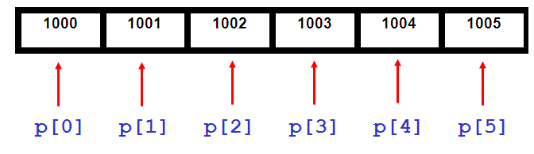
Declaring an Array
So what is actually going on when you set up an array?
Memory:
Each element is held in the next location along in memory
Essentially what the computer is doing is looking at the FIRST address (which is pointed to by the variable p) and then just counts along.

Slide 12
Accessing Elements
To access an array’s element, we need to provide an integral value to identify the index we want to access.
We can do this using a constant: scores[0];
We can also use a variable: for(i = 0; i < 9; i++)
scoresSum += scores[i];

Slide 13
1D Array Representation in C
Memory
a
b
c
d
start_address
Example: 1-dimensional array x = [a, b, c, d]
Map into contiguous memory locations
Location(x[i]) = start_address + W*i
where
start_address: the address of the first element in the array
W: size of each element in the array

Slide 14
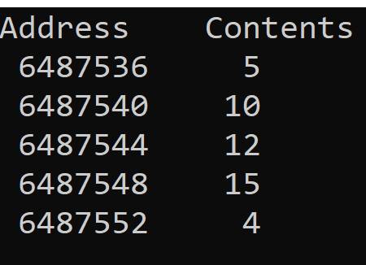
Example
Write a C program that gives the address of each element of an 1D array:
#include <stdio.h>
int main()
{ int A[ ] = {5, 10, 12, 15, 4};
int rows=5;
/* print the address of 1D array by using pointer */
int *ptr = A;
printf("Address Contents\n");
for (int i=0; i < rows; i++)
printf("%8u %5d\n", ptr+i, *(ptr+i));
}
Result in DevC
(sizeof(int)=4)
ptr+i : address of element A[i]
*(ptr+i) : content of element A[i]
Result in turboC
(sizeof(int)=2)
Address Contents
65516 5
65518 10
65520 12
65522 15
65524 4
Memory
Location(A[i]) = start_address + W*i
5
10
12
15
4
start_address=6487536
Notes:
%u' treats the integer as unsigned, whereas ‘%d' treats the integer as signed.

Slide 15
Arrays in C
int list[5], *plist[5];
list[5]: five integers
list[0], list[1], list[2], list[3], list[4]
*plist[5]: five pointers to integers
plist[0], plist[1], plist[2], plist[3], plist[4]
Implementation of 1-D array
list[0] start address = α
list[1] α + sizeof(int)
list[2] α + 2*sizeof(int)
list[3] α + 3*sizeof(int)
list[4] α + 4*size(int)
Compare int *list1 and int list2[5]:
Same: list1 and list2 are pointers.
Difference: list2 reserves five locations.
Notations:
list2 : a pointer to list2[0]
(list2 + i) : a pointer to list2[i] (&list2[i])
*(list2 + i) : content of list2[i]

Slide 16
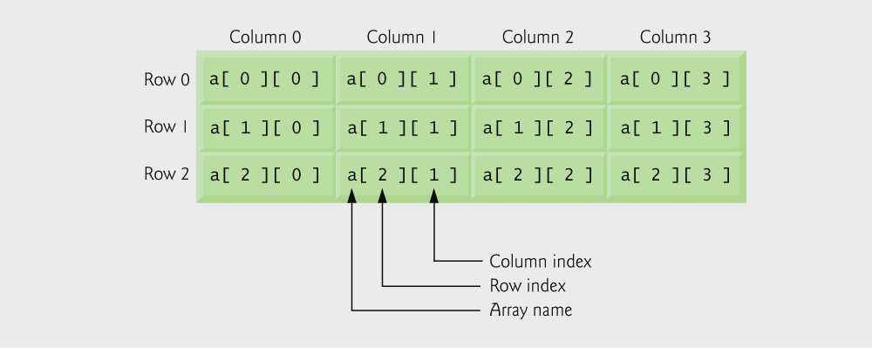
Declaring two-dimensional array
How to declare:
<element-type> <arrayName> [size1][size2];
Example: double a[3][4];
may be shown as a table
Using the two-dimensional array initializer
Example: int a[3][4] = {1,2,3,4,5,6,7,8,9,10,11,12};
Access to element of array: a[2] [1];
a[0][0] = 1 | a[0][1]=2 | a[0][2]=3 | a[0][3]=4
a[1][0] = 5 | a[1][1]=6 | a[1][2]=7 | a[1][3]=8
a[2][0] = 9 | a[2][1]=10 | a[2][2]=11 | a[2][3]=12

Slide 17
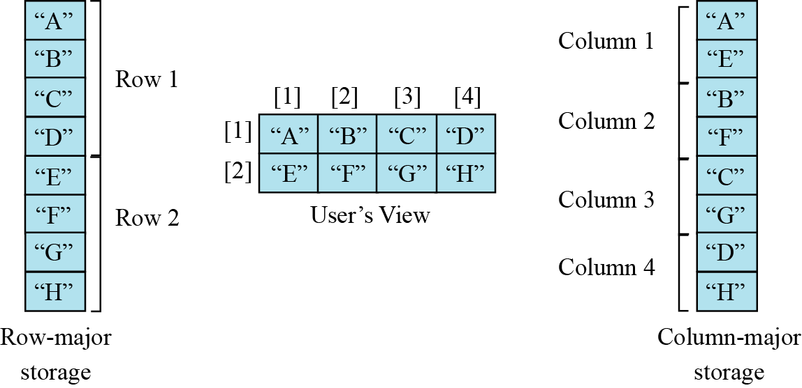
Representation of Arrays
Multidimensional arrays are usually implemented by one dimensional array via either row major order or column major order.

Slide 18
Row-Major Mapping (e.g. Pascal, C/C++)
Row- major order is a method of representing multi-dimensional array in sequential memory. In this method, elements of an array are arranged sequentially row by row. Thus, elements of the first row occupies the first set of memory locations reserved for the array, elements of the second row occupies the next set of memory and so on.
Example: int a[4][3]
Elements of Row 0 | Elements of Row 1 | Elements of Row 2 | …. | Elements of Row i | ……..
in ascending direction of memory address
a[0][0]
a[0][1]
a[0][2]
row 0
row 1
row 2
row 3

Slide 19
Two Dimensional Array Row Major Order
Col 0
Col 1
Col 2
Col c
Row 0
X
X
X
X
Row 1
X
X
X
X
Row r
X
X
X
X
c
elements
c
elements
Row 0
Row 1
Row i
Row r
i * c element

Slide 20
Column-Major Mapping (e.g. Matlab, Fortran)
In this method, elements of an array are arranged sequentially column by column. Thus, elements of the first column occupies the first set of memory locations reserved for the array, elements of the second column occupies the next set of memory and so on.
Example 3 x 4 array:
a b c d
e f g h
i j k l
Convert into 1D array Y by collecting elements by columns.
Within a column elements are collected from top to bottom.
Columns are collected from left to right.
Thus, we get Y[ ] =
{a, e, i, b, f, j, c, g, k, d, h, l}
Elements of column 0 | Elements of column 1 | Elements of column 2 | …. | Elements of column i | ……..

Slide 21
Row- and Column-Major Mappings
2D array: r rows, c columns
Example: int a[3][6]={0,1,2,3,4,5,6,7,8,9,10,11,12,13,14,15,16,17};
a[0][0]=0 a[0][1]=1 a[0][2]=2 a[0][3]=3 a[0][4]=4 a[0][5]=5
a[1][0]=6 a[1][1]=7 a[1][2]=8 a[1][3]=9 a[1][4]=10 a[1][5]=11
a[2][0]=12 a[2][1]=13 a[2][2]=14 a[2][3]=15 a[2][4]=16 a[2][5]=17
Memory: row-major order
c elements of Row 0 | c elements of Row 1 | c elements of Row 2 | …. | c Elements of Row r | ……..
0 | 1 | 2 | 3 | 4 | 5 | 6 | 7 | 8 | 9 | 10 | 11 | 12 | 13 | 14 | 15 | 16 | 17
6 elements of row 0
6 elements of row 1
6 elements of row 2
Memory: column-major order
r Elements of column 0 | r Elements of column 1 | r Elements of column 2 | …. | r Elements of column i | ……..
0 | 6 | 12 | 1 | 7 | 13 | 2 | 8 | 14 | 3 | 9 | 15 | 4 | 10 | 16 | 5 | 11 | 17
3 elements of col 0
3 elements of col 5

Slide 22
Locating Element x[i][j]: row-major order
Assume x:
has r rows and c columns (thus, each row has c elements)
Locating element x[i][j]:
i rows to the left of row i ➔ so i*c elements to the left of x[i][0]
x[i][j] is mapped to position: i*c + j of the 1D array
The location of element x[i][j]:
Location(x[i][j]) =start_address + W (i*c + j)
Where
start_address: the address of the first element (x[0][0]) in the array
W: is the size of each element
c: number of columns in the array
r: number of rows in the array
c elements of Row 0 | c elements of Row 1 | c elements of Row 2 | …. | c Elements of Row r-1 | ……..

Slide 23
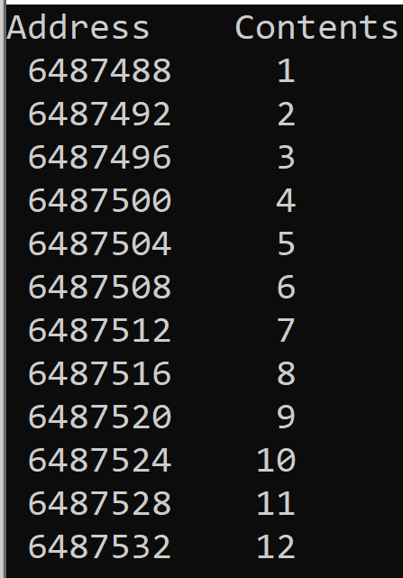
Example
Write a C program that gives the address of each element of a 2D array:
#include <stdio.h>
int main()
{ int a[3] [4] = {1,2,3,4,5,6,7,8,9,10,11,12};
int rows=3, cols =4;
/* print the address of 2D array by using pointer */
int *ptr = a;
printf("Address Contents\n");
for (int i=0; i < rows; i++)
for (int j=0; j < cols; j++)
printf("%8u %5d\n", ptr +((i*cols)+j), *(ptr+ ((i*cols)+j)) );}
Result in DevC
(sizeof(int)=4)
Memory
Location(a[i][j]) = start_address + W*[(i*cols) + j]
 |  | 1 | 2 | 3 | 4 | 5 | 6 | 7 | 8 | 9 | 10 | 11 | 12
Location(a[1][2]) = ?
start_address=6487488
Notes:
%u' treats the integer as unsigned, whereas ‘%d' treats the integer as signed.

Slide 24
Example row-major order: Memory allocation for 2D array (type int)
Address (location) of elements in 2D array:
int a[4][3]
a[0][0] address = α
a[0][1] α + 1*sizeof(int)
a[0][2] α + 2*sizeof(int)
a[1][0] α + 3*sizeof(int)
a[1][1] α + 4*sizeof(int)
a[1][2] α + 5*sizeof(int)
a[2][0] α + 6*sizeof(int)
. . .
General: Declare
int a[m][n];
Assume: the address of the first element (a[0][0]) is α.
Then, the address of element a[i][j] is:
α + (i*n + j)*sizeof(int)

Slide 25
Locating Element x[i][j]: column-major order
….. | r Elements of column 0 | r Elements of column 1 | r Elements of column 2 | …. | r Elements of columns i | …….
Assume x:
has r rows and c columns (thus, each column has r elements)
Locating element x[i][j]:
j columns to the left of column j ➔ so j*r elements to the left of x[0][j]
x[i][j] is mapped to position: j*r + i of the 1D array
The location of element x[i][j]:
Location(x[i][j]) = start_address + W (j*r + i)
Where
start_address: the address of the first element in the array
W: is the size of each element
c: number of columns in the array
r: number of rows in the array
Example: array : int a[3][4]={1,2,3,4,5,6,7,8,9,10,11,12};
Determine the address of the element a[1][2] if start_address = 6487488

Slide 26
Example 1: Row- and Column-Major Mappings
2D array:
int a[3][4] = {1,2,3,4,5,6,7,8,9,10,11,12};
a[0][0] = 1 | a[0][1]=2 | a[0][2]=3 | a[0][3]=4
a[1][0] = 5 | a[1][1]=6 | a[1][2]=7 | a[1][3]=8
a[2][0] = 9 | a[2][1]=10 | a[2][2]=11 | a[2][3]=12
Memory: row-major order
Location(a[i][j]) = start_address + W*[(i*cols) + j]
 |  | 1 | 2 | 3 | 4 | 5 | 6 | 7 | 8 | 9 | 10 | 11 | 12
start_address=6487488
Location(a[1][2]) = ?
Memory: column-major order
Location(a[i][j]) = start_address + W*[(j*rows) + i]
 |  | 1 | 5 | 9 | 2 | 6 | 10 | 3 | 7 | 11 | 4 | 8 | 12
Location(a[1][2]) = ?
start_address=6487488
Notes:
%u' treats the integer as unsigned, whereas ‘%d' treats the integer as signed.

Slide 27
Example 2: Row- and Column-Major Mappings
2D array: r rows, c columns
Example: int a[3][6]={0,1,2,3,4,5,6,7,8,9,10,11,12,13,14,15,16,17};
a[0][0]=0 a[0][1]=1 a[0][2]=2 a[0][3]=3 a[0][4]=4 a[0][5]=5
a[1][0]=6 a[1][1]=7 a[1][2]=8 a[1][3]=9 a[1][4]=10 a[1][5]=11
a[2][0]=12 a[2][1]=13 a[2][2]=14 a[2][3]=15 a[2][4]=16 a[2][5]=17
Memory: row-major order
start_address = 1000 ➔ Location(a[1][4]) = ?
c elements of Row 0 | c elements of Row 1 | c elements of Row 2 | …. | c Elements of Row r | ……..
0 | 1 | 2 | 3 | 4 | 5 | 6 | 7 | 8 | 9 | 10 | 11 | 12 | 13 | 14 | 15 | 16 | 17
6 elements of row 0
6 elements of row 1
6 elements of row 2
Memory: column-major order
r Elements of column 0 | r Elements of column 1 | r Elements of column 2 | …. | r Elements of column i | ……..
0 | 6 | 12 | 1 | 7 | 13 | 2 | 8 | 14 | 3 | 9 | 15 | 4 | 10 | 16 | 5 | 11 | 17
3 elements of col 0
3 elements of col 5

Slide 28
Example: Memory mapping
char A[3][4]; // row-major
logical structure physical structure
0
1
2
3
A[0][0]
0
A[0][1]
1
A[0][2]
A[0][3]
2
A[1][0]
A[2][1]
A[1][1]
A[1][2]
A[1][3]
Mapping (location):
Location(A[i][j]) = Location(A[0][0])+ i*4+j

Slide 29
Example
We have stored the two-dimensional array students in memory. The array is 100 × 4 (100 rows and 4 columns). Show the address of the element students[5][3] assuming that the element student[0][0] is stored in the memory location with address 1000 and each element occupies only two bytes memory location. The computer uses row-major storage.
Solution:
Notes:
Y = x + cols * (i-1) + (j-1)=1018

Slide 30
Operations on the array
The common operations on arrays are searching, insertion, deletion, retrieval and traversal.
Example: Given an array S consists of n integers: S[0], S[1], …, S[n-1]
Search operation: search a value whether appears in the array S or not
function Search(S,value) returns true if value appears in S; false otherwise
Retrieval operation: get the value of the element at index i of the array S
function Retrieve(S, i): returns the value S[i] if 0 <= i <= n-1
Traversal operation: print the value of all elements in the array S
function PrintArray(S, n)
Insert operation: insert a value into the array S
Delete operation: delete the element at index i of the array S
Although searching, retrieval and traversal of an array is an easy job, insertion and deletion is time consuming. The elements need to be shifted down before insertion and shifted up after deletion.
Notes:
Item Retrieve(A, i) ::= if (i ∈ index) return the item associated with index value i in array A

Slide 31
Inserting an element into an array
Assume we need to insert 8 into an array already be sorted in ascending order:
1
3
3
7
12
14
17
19
22
30
We can do it by shifting to the right one cell for all the elements after the mark
It thus need to remove 30 from the array
1
3
3
7
8
12
14
17
19
22
30
• Moving all elements of the array is a slow operation (requires linear time O(n) where n is the size of array)

Slide 32
Deleting an element from an array
In order to delete an element, we need to shift to the left all previous elements
1
3
3
7
8
12
14
17
19
22
1
3
3
7
12
14
17
19
22
?
Delete operation is a slow operation.
Regular implementation of this operation is undesirable.
Delete operation makes the last index free
How we could mark the last index of the array being free?
We need variable to store the size of the array
Example: variable size is used to store the size of the array. Before deletion, size = 10. After deletion, we need to update the value of size: size = 10 – 1 = 9

Slide 33

Operations on the array
Thinking about the operations discussed in the previous section gives a clue to the application of arrays. If we have a list in which a lot of insertions and deletions are expected after the original list has been created, we should not use an array. An array is more suitable when the number of deletions and insertions is small, but a lot of searching and retrieval activities are expected.
i
An array is a suitable structure when a small number of insertions and deletions are required, but a lot of searching and retrieval is needed.

Slide 34
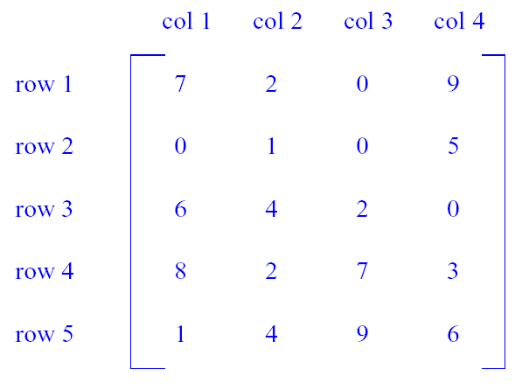
Represent Matrices based on arrays
m x n matrix is a table with m rows and n columns, but numbering begins at 1 rather than 0.
M(i,j) denotes the element in row i and column j.
Common matrix operations
transpose
addition
Multiplication
Shortcomings Of Using A 2D Array For A Matrix:
Indexes are off by 1.
C arrays do not support matrix operations such as add, transpose, multiply, and so on.
Suppose that x and y are 2D arrays. Can’t do x + y, x –y, x * y, etc. in C.
➔We need to develop functions to support all matrix operations.

Slide 35
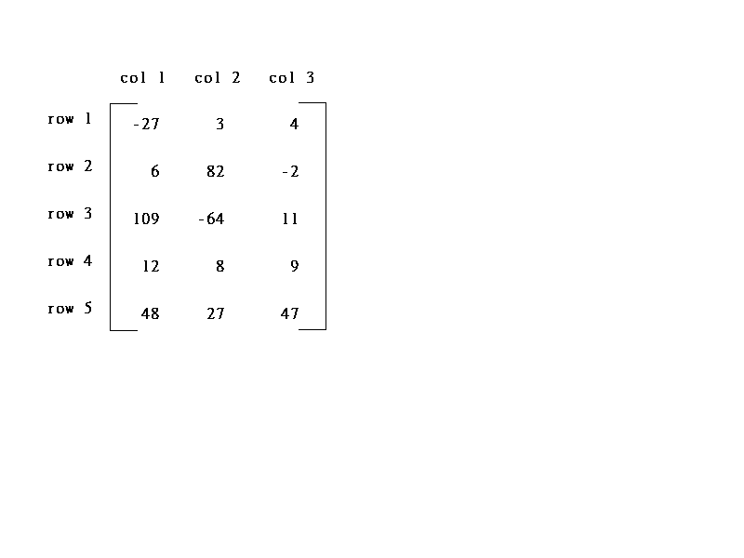
Sparse Matrix
col1 col2 col3 col4 col5 col6
row1
row2
row3
row4
row5
row6
5*3
6*6
15/15
8/36
sparse matrix
data structure?

Slide 36
Sparse Matrix
(1) Represented by a two-dimensional array (e.g. int M[6][6];)
Sparse matrix wastes space.
(2) Each element is characterized by <row, col, value>.
The terms in A should be ordered based on <row, col>
row col value A [0] 1 1 15 [1] 1 4 22 [2] 1 6 -15 [3] 2 2 11 [4] 2 3 3 [5] 3 4 -6 [6] 5 1 91 [7] 6 2 28
col1 col2 col3 col4 col5 col6
row1
row2
row3
row4
row5
row6
A[0][0] = 1;
A[0][1] = 1;
A[0][2] = 15
A[5][0] = 3;
A[5][1] = 4;
A[5][2] = -6;
6*6
/* Array representation of sparse matrix
//[ ][0] represents row
//[ ][1] represents col
//[ ][2] represents value */
int MAX = 8; //number of elements != 0 in sparse matrix
int A[MAX][3];

Slide 37
Diagonal Matrix
1 0 0 0
0 2 0 0
0 0 3 0
0 0 0 4
An n x n matrix in which all nonzero terms are on the diagonal.
M(i, j) is on diagonal iff i = j
number of diagonal elements in an n x n matrix is n
non diagonal elements are zero
Store diagonal only vs n² whole:
int M[5];
int M[5][5];

Slide 38
Triangular Matrix
1 0 0 0
2 3 0 0
4 5 6 0
7 8 9 10
An n x n matrix in which all nonzero terms are either on or below the diagonal.
M(i,j) is part of lower triangle iff i >= j
Number of elements in lower triangle is
1 + 2 + … + n = n(n+1)/2
Store n² whole vs only the lower triangle:
Store n² whole:
Use 2D array A[n][n]
Store only the lower triangle by:
Option 1: Map lower triangular into a 1D array
Option 2: Irregular 2D array

Slide 39
Option 1: Map Lower Triangular Array into a 1D array
Use row-major order, but omit terms that are not part
of the lower triangle.
For the matrix
1 0 0 0
2 3 0 0
4 5 6 0
7 8 9 10
we get 1D array:
1, 2, 3, 4, 5, 6, 7, 8, 9, 10

Slide 40
Index of element M(i,j) in 1D array
For the matrix M_{4x4}
1 0 0 0
2 3 0 0
4 5 6 0
7 8 9 10
we get 1D array:
1, 2, 3, 4, 5, 6, 7, 8, 9, 10
Order is: row 1, row 2, row 3, …
Row i is preceded by rows 1, 2, …, i-1
Size of row i (number of elements in row i ) is i
Number of elements that precede row i is
1 + 2 + 3 + … + i-1 = i(i-1)/2
➔ So element M(i, j) is at position i(i-1)/2 + j-1 of the 1D array
Example: M(3, 2) is at position 3(3-1)/2 + 2-1 = 4
Row 1
0
1
3
6
r 1
r2
r3
…
row i

Slide 41
Option 2: Map Lower Triangular Array into Irregular 2D Arrays
x[]
Store only the lower triangle:
1 0 0 0
2 3 0 0
4 5 6 0
7 8 9 10
1
2
3
4
5
6
7
8
9
l0
Irregular 2-D array: the length of rows is not required to be the same.

Slide 42
Creating and Using Irregular 2D Arrays
// STEP 1: declare a two-dimensional array variable
int ** iArray = new int*[numberOfRows];
OR:
int ** iArray;
malloc(iArray, numberOfRows*sizeof(*iArray));
//STEP 2: allocate the desired number of rows
// now allocate space for elements in each row
for (int i = 0; i < numberOfRows; i++)
iArray[i] = new int [length[i]];
OR:
for (int i = 0; i < numberOfRows; i++)
malloc(iArray[i], length[i]*sizeof(int));
// STEP 3: use the array like any regular array:
iArray[2][3] = 5;
iArray[4][6] = iArray[2][3]+2;
iArray[1][1] += 3;

Slide 43
Contents
2.1. Array
2.2. Record
2.3. Linked List
2.4. Stack
2.5. Queue

Slide 44
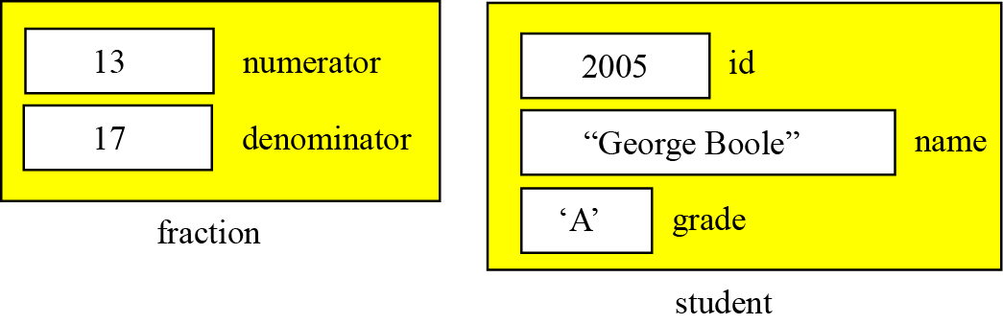
2.2. Record
A record is a collection of related elements, possibly of different types, having a single name.
Each element in a record is called a field:
A field has a type and exists in memory.
Fields can be assigned values, which in turn can be accessed for selection or manipulation.
Example: Figure below contains two examples of records.
The first example: fraction has two fields: numerator and denominator, both of which are integers.
The second example: student has three fields (id, name, grade) made up of three different types.

Slide 45
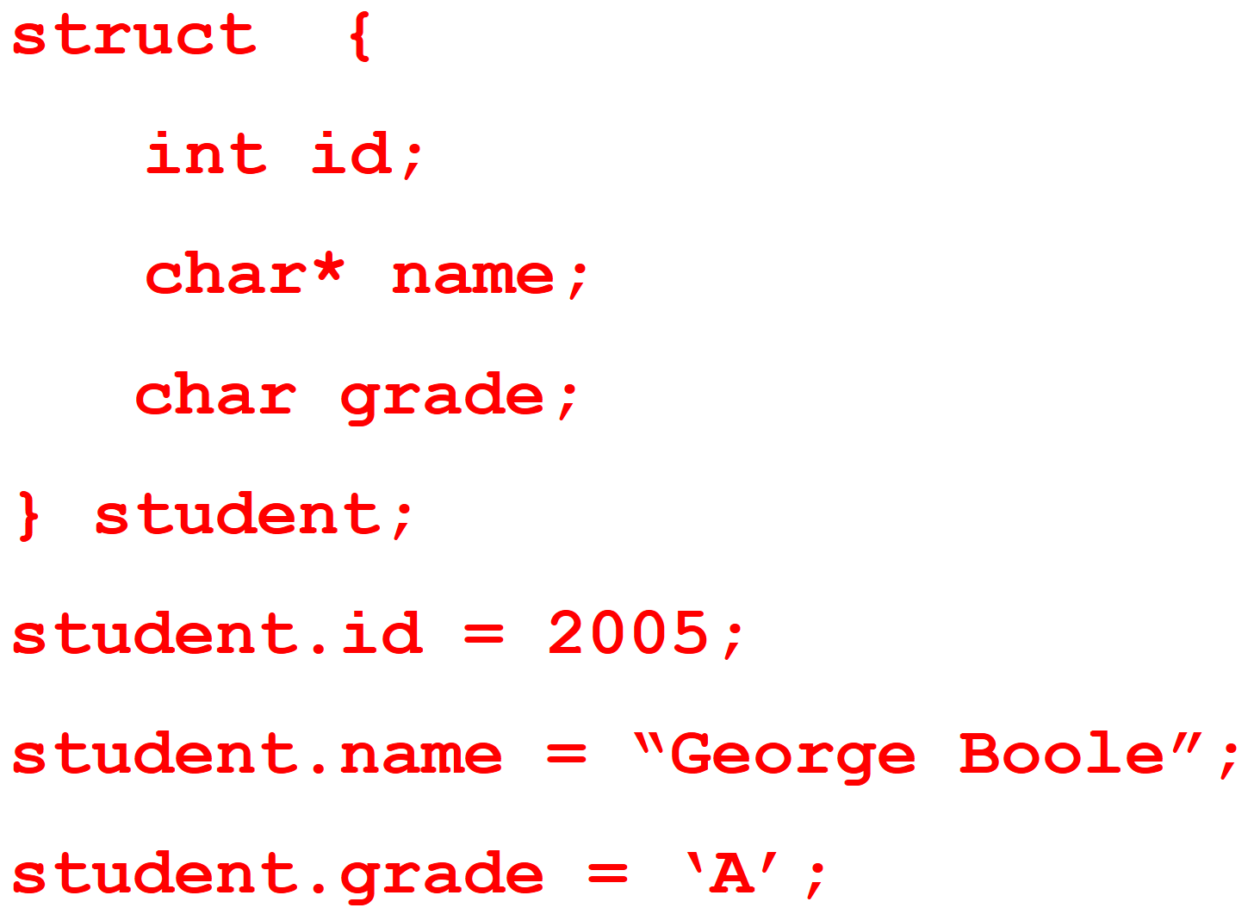
2.2. Record
Example:
struct {
int numerator;
int denominator;
} fraction;
fraction.numerator = 13;
fraction.denominator = 17;

Slide 46
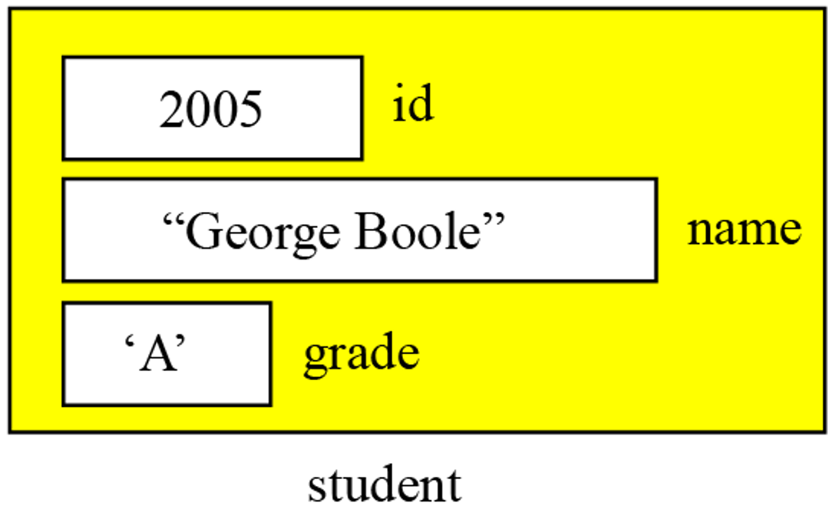
Record name vs. field name
Just like in an array, we have two types of identifier in a record:
the name of the record, and
the name of each individual field inside the record.
The name of the record is the name of the whole structure, while the name of each field allows us to refer to that field.
Example: in the student record:
the name of the record is student,
the name of the fields are student.id, student.name and student.grade.
Most programming languages use a period (.) to separate the name of the structure (record) from the name of its components (fields).

Slide 47
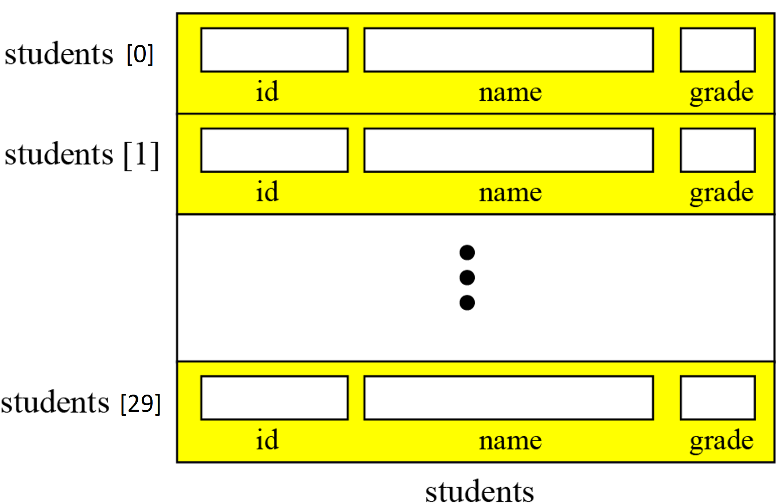
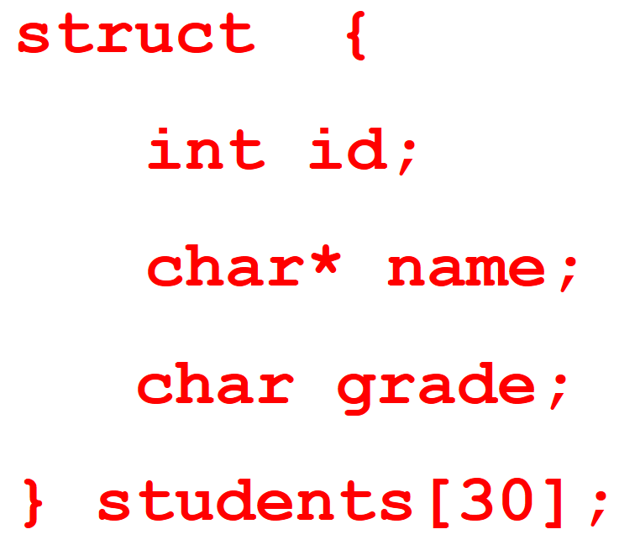
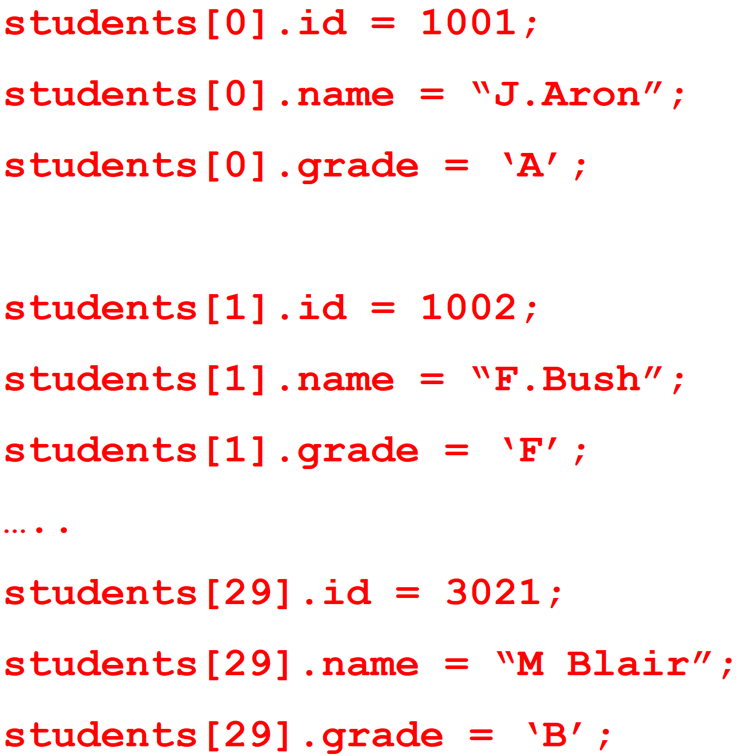
Comparison of records and arrays
We can compare an array with a record. This helps us to understand when we should use an array and when to use a record:
An array defines a combination of elements, while a record defines the identifiable parts of an element.
For example, an array can define a class of students (40 students), but a record defines different attributes of a student, such as id, name or grade.
Array of records: If we need to define a combination of elements and at the same time some attributes of each element, we can use an array of records. For example, in a class of 30 students, we can have an array of 30 records, each record representing a student.
Figure 1. Array of records

Slide 48
Contents
2.1. Array
2.2. Record
2.3. Linked List
2.4. Stack
2.5. Queue

Slide 49
2.3. Linked list
Singly linked list
Doubly linked list
Circular linked list
10
8
20
head
10
8
20
head
head
10
8
20

Slide 50
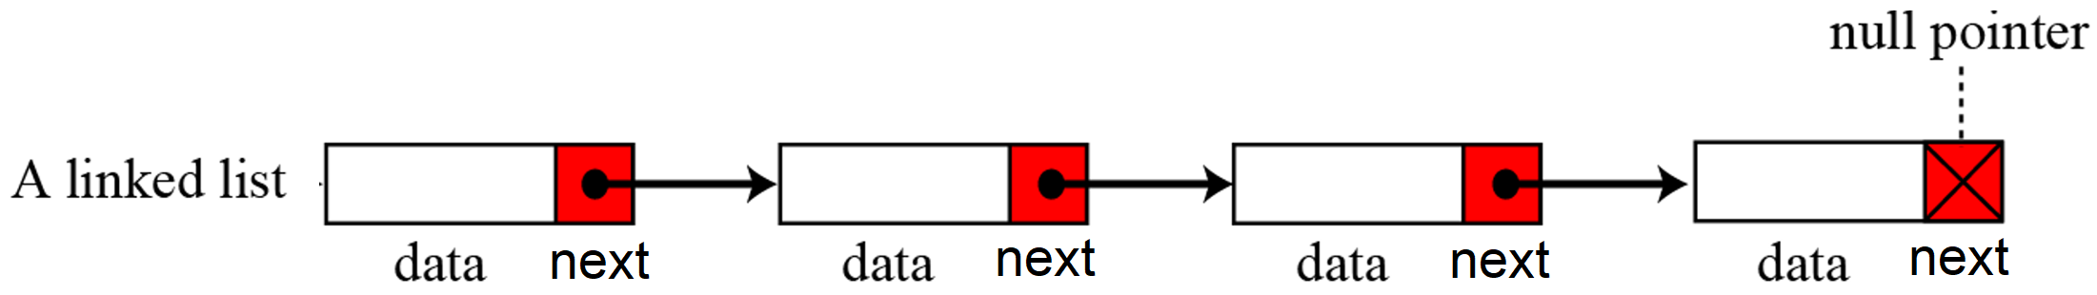
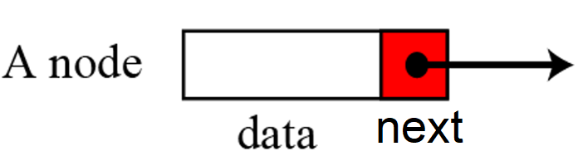
Singly Linked list
A singly linked list is a sequences of nodes, each node contains 2 parts: data and reference (address) to the next node.
Example: Figure shows a singly linked list contains four nodes:
Keeping track of a singly linked list:
Must know the pointer to the first element of the list (called start, head, etc.)
If head is NULL, the singly linked list is empty
10
8
20
head

Slide 51
Singly Linked list
A singly linked list is a sequences of nodes, each node contains 2 parts: data and reference (address) to the next node.
Example: Figure shows a singly linked list contains four nodes:
Keeping track of a singly linked list:
Must know the pointer to the first element of the list (called start, head, etc.)
If head is NULL, the singly linked list is empty
head
a₁
a₂
. . .
a_{n}
NULL
list

Slide 52
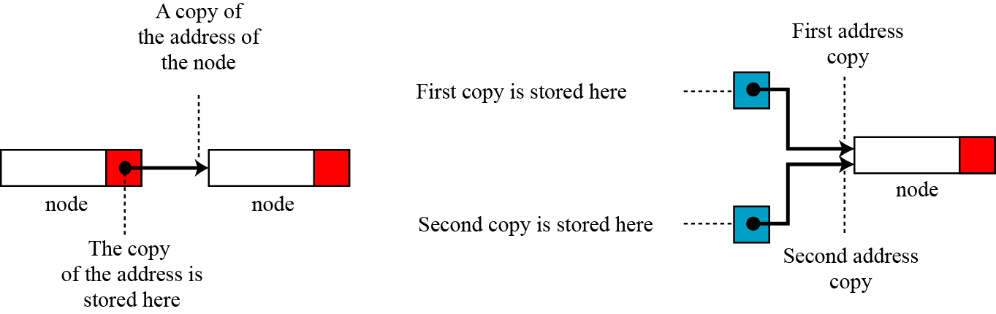
Singly Linked list
Before further discussion of singly linked lists, we need to explain the notation we use in the figures. We show the connection between two nodes using a line. One end of the line has an arrowhead, the other end has a solid circle.
Figure. The concept of copying and storing pointers
Memory address
head
3000 5000 2000
3000 10 5000 8 2000 50 NULL

Slide 53
Declare singly linked list in C programming language
..
List of integer numbers:
List of students with data: student’s ID, grade of math and physics
List of contacts with data: name, phone number
➔ Need to declare:
the type of data in the node first,
then the singly linked list consists of (1) data of the node, and (2) the pointer to store the address of the next node in the list
7
17
4
24
…
2001 8.5 6.5
2002 7 4.5
4001 6.5 9
…
Crainic 0903210433
Michel 0941341043
Gendreau 0894312098

Slide 54
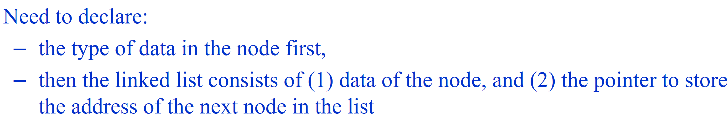
Declare singly linked list
typedef struct {
.....
}NodeType;
typedef struct {
NodeType data;
struct node* next;
}node;
node* head;
Define the type of data of the node
Define the singly linked list
This declaration define node which is a record consisting of 2 fields:
data : stores data of node, has the type NodeType (which was defined in typedef…NodeType, and could consist of several attributes)
next : the pointer which stores the address of the next node in the list
Pointer head : store address of the first node in the list
Example1: List of students with data: id of student, marks of 2 subjects: math, physics
typedef struct{
char id[15];
float math, physics;
}student;
typedef struct {
student data;
struct node* next;
}node;
node* head;
Define the type of data of the node
data
id math physics
next
A node

Slide 55
Declare singly linked list
typedef struct {
.....
}NodeType;
typedef struct {
NodeType data;
struct node* next;
}node;
node* head;
Define the type of data of the node
Define the singly linked list
This declaration define node which is a record consisting of 2 fields:
data : stores data of node, has the type NodeType (which was defined in typedef…NodeType, and could consist of several attributes)
next : the pointer which stores the address of the next node in the list
Pointer head : store address of the first node in the list
Example2: List of integer numbers
typedef struct {
int data;
struct node* next;
}node;
node* head;
7
17
4
24
“int” is the type of node, so do not need to use “typedef….NodeType” to define the type
data
A node

Slide 56
Declare singly linked list
typedef struct {
.....
}NodeType;
typedef struct {
NodeType data;
struct node* next;
}node;
node* head;
Define the type of data of the node
Define the singly linked list
This declaration define node which is a record consisting of 2 fields:
data : stores data of node, has the type NodeType (which was defined in typedef…NodeType, and could consist of several attributes)
next : the pointer which stores the address of the next node in the list
Pointer head : store address of the first node in the list
Example 3: List of contacts with data: name and phone number
typedef struct{
char name[15];
char phone[20];
}contact;
typedef struct {
contact data;
struct node* next;
}node;
node* head;
Define the type of data of the node
data
name phonenumber
next
A node

Slide 57
Important elements of singly linked list
head: store the address of the first node in the linked list
NULL: value of the pointer of the last node in the linked list
cur: the pointer stored the address of current node
Allocate memory for a new node pointed by the pointer newNode in the list:
node *newNode = (node *) malloc(sizeof(node));
Access to the data of the node pointed by pointer newNode :
newNode->data
Free memory allocated for node pointed by pointer newNode :
free(newNode);
cur
head (or root)
NULL
newNode

Slide 58
Operations on singly linked Lists
Traverse the singly linked list
Insert a node into the singly linked list
Delete a node from the singly linked list
Search data in the singly linked list

Slide 59
Operations on singly linked Lists
Traverse the singly linked list
Insert a node into the singly linked list
Delete a node from the singly linked list
Search data in the singly linked list

Slide 60
Traversing a singly linked list
for ( cur = head; cur != NULL; cur = cur->next )
showData_Of_Current_Node( cur->data );
cur
head
NULL
Change the value of the pointer cur
Finish to browse the list when the NULL value is encountered
cur
head
NULL

Slide 61
Exercise 1
A sequence of integers is stored by a singly linked list.
typedef struct Node{
int data;
struct Node *next;
}Node;
Node *head;
Create a list stored 3 integers: 1, 2, 3
Print the list of these 3 integers
head
1
2
3
NULL

Slide 62
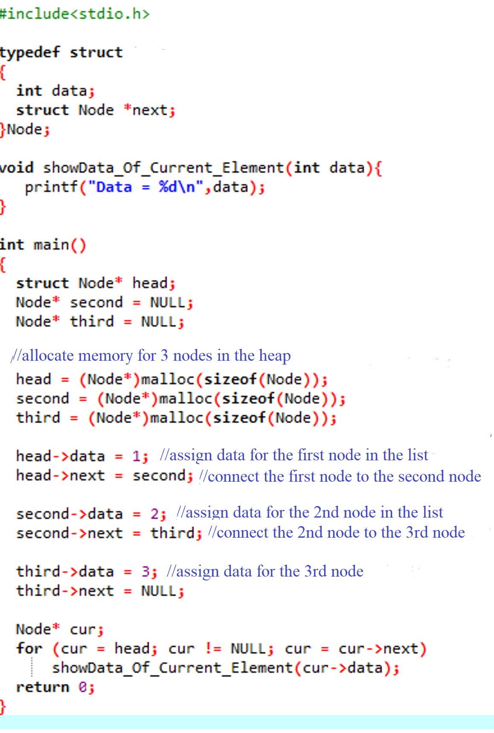
head
second
third
1
2
3
NULL
cur
Data = 1
Data = 2
Data = 3

Slide 63
Operations on singly linked lists
Traverse the singly linked list
Insert a node into the singly linked list
Delete a node from the singly linked list
Search data in the singly linked list

Slide 64
Operations on singly linked list: Insertion
Insert a new node :
At the beginning of the list
After the position pointed by the pointer cur
Before the position pointed by the pointer cur
At the end of the list
cur
head
…

Slide 65
Operations on singly linked list: Insertion
Insert a new node:
At the beginning of the list
<create a new node new_node>;
new_node ->next = head;
head= new_node;
head
…
node *Insert_ToHead(node *head, NodeType X)
{ node *new_node;
new_node = (node *) malloc(sizeof(node));
new_node->data = X;
new_node->next = head;
head=new_node;
return head;
}
new_node

Slide 66
Operations on singly linked list: Insertion
Insert a new node :
At the beginning of the list
After the position pointed by the pointer cur
Before the position pointed by the pointer cur
At the end of the list
cur
head
…

Slide 67
Operations on singly linked list: Insertion
Insert a new node after the node pointed by the pointer cur:
<create a new node new_node>;
new_node ->next = cur->next;
cur->next = new_node;
cur
head
…
new_node

Slide 68
Operations on singly linked list: Insertion
Insert a new node after the node pointed by the pointer cur:
<create a new node new_node>;
new_node ->next = cur->next;
cur->next = new_node;
Write a function to insert a node with data = X (having the type «NodeType » after the
node pointed by the pointer cur. The function returns the address of the new node:
node *Insert_After(node *cur, NodeType X)
{ node *new_node;
new_node = (node *) malloc(sizeof(node)); //(1)
new_node -> data = X; //(1)
new_node->next = cur->next; //(2)
cur->next = new_node; //(3)
return new_node;
}

Slide 69
Operations on singly linked list: Insertion
Insert a new node after the node pointed by the pointer cur:
<create a new node new_node>;
new_node ->next = cur->next;
cur->next = new_node;
?? Empty list
// wrong implementation:
cur->next = new_node;
new_node ->next = cur->next;
cur
head
…
new_node

Slide 70
Operations on singly linked list: Insertion
Insert a new node after the node pointed by the pointer cur:
<create a new node new_node>;
new_node ->next = cur->next;
cur->next = new_node;
?? Empty list
<create a new node new_node>;
if (head == NULL) { /* list does not have any node yet */
head = new_node;
cur = head;
}
else {
new_node ->next = cur->next;
cur->next = new_node;
}

Slide 71
Operations on singly linked list: Insertion
Insert a new node :
At the beginning of the list
After the position pointed by the pointer cur
Before the position pointed by the pointer cur
At the end of the list
cur
head
…

Slide 72
Operations on singly linked list: Insertion
Insert a new node before the node pointed by the pointer cur
<create a new node new_node>;
prev->next = new_node;
new_node>next = cur;
?? List does not have any node yet
?? cur is the first node in the list
prev
cur
head
…
Insert a new node:

Slide 73
Operations on singly linked list: Insertion
Insert a new node before the node pointed by the pointer cur
<create a new node new_node>;
prev->next = new_node;
new_node->next = cur;
?? List does not have any node yet
?? cur is the first node in the list
<create a new node new_node>;
if (head == NULL) { /* list does not have any node yet */
head = new_node;
cur = head;
}
else if (cur == head) { //cur us the first node in the list
head = new_node;
new_node->next = cur;
}
else {
prev->next = new_node;
new_node->next = cur;
}

Slide 74
Operations on singly linked list: Insertion
head
Insert a new node:
At the beginning
After the node pointed by cur
Before the node pointed by cur
At the end of the list
…
<create a new node new_node>;
if (head == NULL) { /* list does not have any node yet*/
head = new_node;
}
else {
//move the pointer to the end of the list:
node *last =head;
while (last->next != NULL) last = last->next;
//Change the pointer next of the last node:
last->next = new_node;
}
node *Insert_ToLast(node *head, NodeType X)
{ node *new_node;
new_node = (node *) malloc(sizeof(node));
new_node->data = X;
if (head == NULL) head = new_node;
else
{
node *last;
last=head;
while (last->next != NULL) // move to the last node
last = last->next;
last->next = new_node;
}
return head;
}
Complexity is ….

Slide 75
Operations on singly linked Lists
Traverse the singly linked list
Insert a node into the singly linked list
Delete a node from the singly linked list
Search data in the singly linked list

Slide 76
Operations on singly linked lists: Deletion
Delete a node
Delete all nodes of the list

Slide 77
Operations on singly linked lists: Deletion
Delete a node:
The first node of the list
Middle/last node of the list
head
≡del
del
head
…

Slide 78
Delete the first node of the list
Delete the node del that is currently the first node of the list:
head = del->next;
free(del);
del
head
NULL

Slide 79
Delete the node at the middle/end of the list
Delete node del that is currently the middle/last node of the list:
<Determine the pointer prev pointed to the previous node of del>;
prev->next = del->next; //modify the link
free(del); //delete node del to free memory
prev
del
head
prev
del
head
NULL
Notes:
stop here

Slide 80
Delete the node at the middle/end of the list
Delete node del that is currently the middle/last node of the list:
<Determine the pointer prev pointed to the previous node of del>;
prev->next = del->next; //modify the link
free(del); //delete node del to free memory)
Node *prev =head;
while (prev->next != del) prev = prev->next;
prev
del
head
…
Notes:
stop here

Slide 81
Delete the node at the middle/end of the list
Delete node del that is currently the middle/last node of the list:
<Determine the pointer prev pointed to the previous node of del>;
prev->next = del->next; //modify the link
free(del); //delete node del to free memory)
Node *prev =head;
while (prev->next != del) prev = prev->next;
prev
del
head
…
Notes:
stop here

Slide 82
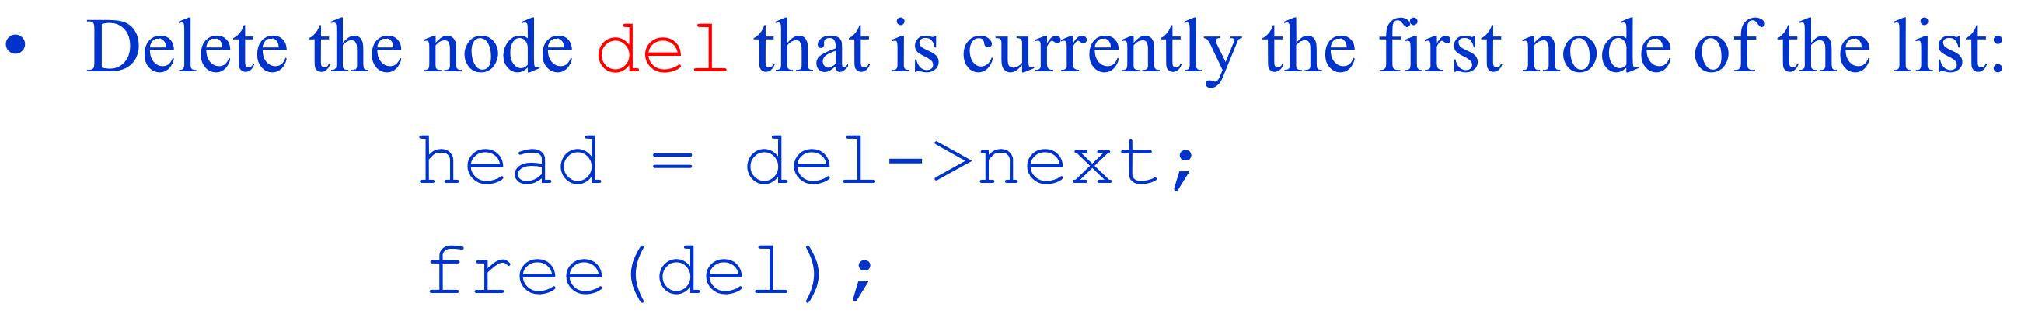
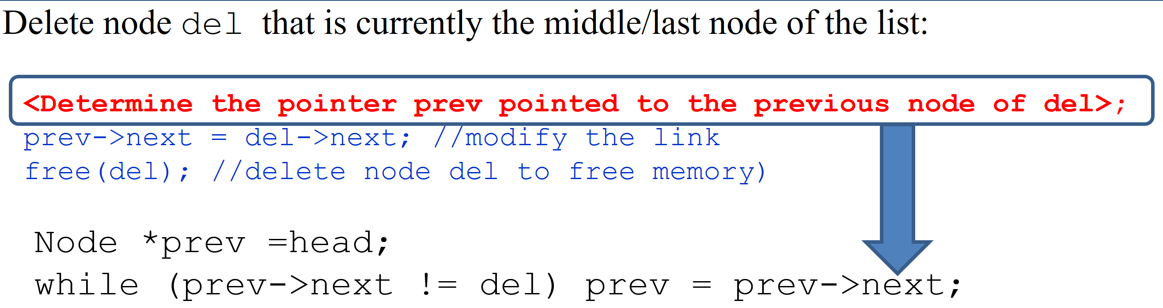
Delete a node pointed by the pointer del
Write the function node *Delete_Node(node *head, node *del)
to delete a node pointed by the pointer “del” of the list with the first node pointed by the pointer “head”.
The function returns the address of the first node in the list after deletion:
node *Delete_Node(node *head, node *del)
{
if (head == del) //del is the first node of the list:
{
head = del->next;
free(del);
}
else{
node *prev = head;
while (prev->next != NULL) prev = prev->next;
prev->next =del->next;
free(del);
}
return head;
}
Notes:
stop here

Slide 83
Operations on singly linked lists: Deletion
Delete a node
Delete all nodes of the list

Slide 84
Freeing all nodes of a list
del = head ;
while (del != NULL)
{
head = head->next;
free(del);
del = head;
}
head
Traverse elements one by one from the head till the end
1
2
3
del

Slide 85
Freeing all nodes of a list
del = head ;
while (del != NULL)
{
head = head->next;
free(del);
del = head;
}
head
2
3
del

Slide 86
Freeing all nodes of a list
del = head ;
while (del != NULL)
{
head = head->next;
free(del);
del = head;
}
head
2
3
del

Slide 87
Freeing all nodes of a list
del = head ;
while (del != NULL)
{
head = head->next;
free(del);
del = head;
}
head
3
NULL
del

Slide 88
Freeing all nodes of a list
Write the function node* deleteList(node* head)
to delete all the node in the list having the first node pointed by the pointer head
The function returns the pointer head after deletion
node* deleteList(node* head)
{
node *del = head ;
while (del != NULL)
{
head = head->next;
free(del);
del = head;
}
return head;
}

Slide 89
Check whether the singly linked list is empty or not
Write the function int IsEmpty(node *head)
to check whether the singly linked list is empty or not (the pointer head pointed to the
first node of the list).
The function returns 1 if the list is empty; 0 otherwise
int IsEmpty(node *head) {
if (head == NULL)
return 1;
else return 0;
}

Slide 90
Operations on singly linked Lists
Traverse the singly linked list
Insert a node into the singly linked list
Delete a node from the singly linked list
Search data in the singly linked list

Slide 91
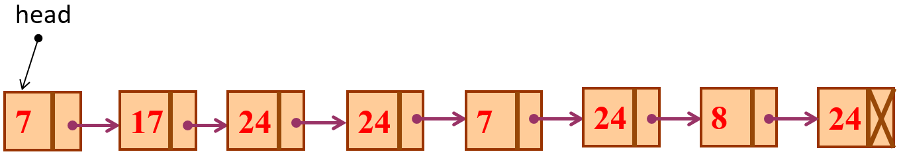
Searching
To search for an element, we traverse from head until we locate the object or we reach the end of the list.
Example: Given a linked list consisting of integer numbers. Count the number of nodes with data field equal to number x.
int countNodes(int x){
int count = 0;
node* e = head;
while(e != NULL){
if(e->data == x) count++;
e = e->next;
}
return count;
}
typedef struct {
int data;
struct node* next;
}node;
node* head;
int Result1 = countNodes(24);
Result1 = ?
Result2 = ?
int a =7;
int Result2 = countNodes(a);
Notes:
Complexity = O(n)

Slide 92
Time Complexity: Singly-linked lists vs. 1D-arrays
Operation | ID-Array Complexity | Singly-linked list Complexity
Insert at beginning | O(n) | O(1)
Insert at end | O(1) | O(1) if the list has tail reference O(n) if the list has no tail reference
Insert at middle* | O(n) | O(n)
Delete at beginning | O(n) | O(1)
Delete at end | O(1) | O(n)
Delete at middle* | O(n): O(1) access followed by O(n) shift | O(n): O(n) search, followed by O(1) delete
Search | O(n) linear search O(log n) Binary search | O(n)
Indexing: What is the element at a given position k? | O(1) | O(n)
* middle: neither at the beginning nor at the end
Notes:
92
O(n)

Slide 93
Singly-linked lists vs. 1D-arrays
ID-array | Singly-linked list
Fixed size: Resizing is expensive | Dynamic size
Insertions and Deletions are inefficient: Elements are usually shifted | Insertions and Deletions are efficient: No shifting
Random access i.e., efficient indexing | No random access → Not suitable for operations requiring accessing elements by index such as sorting
No memory waste if the array is full or almost full; otherwise may result in much memory waste. | Extra storage needed for references; however uses exactly as much memory as it needs
Sequential access is faster because of greater locality of references [Reason: Elements in contiguous memory locations] | Sequential access is slow because of low locality of references [Reason: Elements not in contiguous memory locations]
Notes:
93

Slide 94
2.3. Linked list
Singly linked list
Doubly linked list
10
8
20
head
10
8
20
head
tail

Slide 95
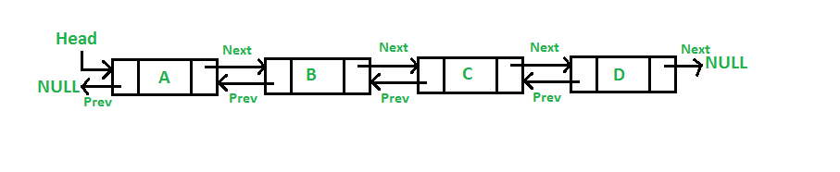
Doubly linked list
A Doubly Linked List (DLL) contains an extra pointer, typically called previous pointer, together with next pointer and data which are there in singly linked list
2 special nodes: tail and head
head has pointer prev = null
tail has pointer next = null
Basic operations are considered similar as in the singly linked list
tail

Slide 96
Doubly linked list
Declare doubly linked list to store integer numbers:
typdedef struct {
int number;
struct dllist *next;
struct dllist *prev;
} dllist;
dllist *head, *tail;
10
8
20
head
tail

Slide 97
Doubly linked list
Declare doubly linked list store data of students: ID, marks of math and physics
typedef struct{
char id[15];
float math, physics;
}student;
typedef struct {
student data;
struct ddlist* next;
struct ddlist* prev;
}dllist;
dllist *head, *tail;
…
2001 8.5 6.5
2002 8 5
4002 5.5 9.5
head
tail

Slide 98
Doubly linked list – Example
typedef struct {
char data;
struct dblist *prev;
struct dblist *next;
}dblist;
dblist node1, node2, node3;
node1.data=‘a’;
node2.data=‘b’;
node3.data=‘c’;
node1.prev=NULL;
node1.next=node2;
node2.prev=node1;
node2.next=node3;
node3.prev=node2;
node3.next=NULL;
a
b
c
NULL
NULL
98

Slide 99
Delete a node pointed by the pointer p
void Delete_Node (ddlist *p){
if (head == NULL) printf(”Empty list”);
else {
if (p==head) head = head->next; //Delete first element
else p->prev->next = p->next;
if (p->next!=NULL) p->next->prev = p->prev;
else tail = p->prev;
free(p);
}
}
8
5
12
5
p
head
tail

Slide 100
Delete a node pointed by the pointer p
void Delete_Node (ddlist *p){
if (head == NULL) printf(”Empty list”);
else {
if (p==head) head = head->next; //Delete first element
else p->prev->next = p->next;
if (p->next!=NULL) p->next->prev = p->prev;
else tail = p->prev;
free(p);
}
}
8
5
12
5
p
head
tail

Slide 101
Delete a node pointed by the pointer p
void Delete_Node (ddlist *p){
if (head == NULL) printf(”Empty list”);
else {
if (p==head) head = head->next; //Delete first element
else p->prev->next = p->next;
if (p->next!=NULL) p->next->prev = p->prev;
else tail = p->prev;
free(p);
}
}
8
5
12
5
p
head
tail

Slide 102
Insert a node after the node pointed by pointer p
void Insert_Node (NodeType X, ddlist *p){
if (head == NULL){ // List is empty
head =(ddlist*)malloc(sizeof(ddlist));
head->data = X;
head->prev =NULL;
head->next =NULL;
}
else{
ddlist *newNode;
newNode=(ddlist*)malloc(sizeof(ddlist));
newNode->data = X;
newNode->next = NULL;
newNode->next = p->next;
newNode->prev=p;
if (p->next!=NULL)
p->next->prev=newNode;
p->next = newNode;
}
}
12
8
5
5
p

Slide 103
Exercise 2: Create a double linked list store integer numbers
#include <stdio.h>
#include <stdlib.h>
#include <conio.h>
typedef struct {
int number;
struct dllist *next;
struct dllist *prev;
} dllist;
dllist *head, *tail;
/* Insert a new node p at the end of the list */
void append_node(dllist *p);
/* Insert a new node p after a node pointed by the pointer after */
void insert_node(dllist *p, dllist *after);
/* Delete a node pointed by the pointer p */
void delete_node(dllist *p);

Slide 104
/* Insert a new node p at the end of the list */
void append_node(dllist *p) {
if(head == NULL)
{
head = p;
p->prev = NULL;
}
else {
tail->next = p;
p->prev = tail;
}
tail = p;
p->next = NULL;
}

Slide 105
/* Insert a new node p after a node pointed by the pointer after */
void insert_node(dllist *p, dllist *after) {
p->next = after->next;
p->prev = after;
if(after->next != NULL)
after->next->prev = p;
else
tail = p;
after->next = p;
}
/* Delete a node pointed by the pointer p */
void delete_node(dllist *p) {
if(p->prev == NULL)
head = p->next;
else p->prev->next = p->next;
if(p->next == NULL)
tail = p->prev;
else p->next->prev = p->prev;
}

Slide 106
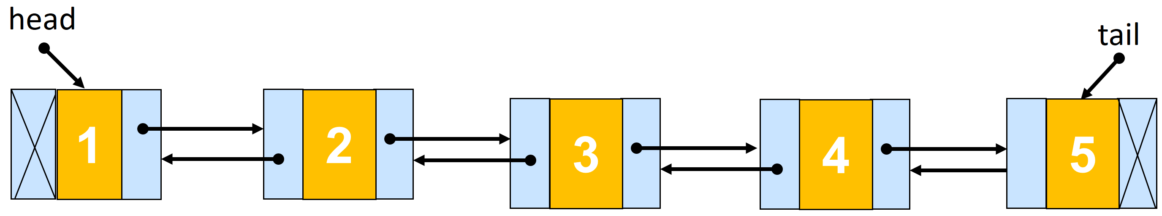
int main( ) {
dllist *tempnode; int i;
/* add some numbers to the double linked list */
for(i = 1; i <= 5; i++) {
tempnode = (dllist *)malloc(sizeof(dllist));
tempnode->number = i;
append_node(tempnode);
}
/* print the dll list forward */
printf(" Traverse the dll list forward \n");
for(tempnode = head; tempnode != NULL; tempnode = tempnode->next)
printf("%d\n", tempnode->number);
/* print the dll list backward */
printf(" Traverse the dll list backward \n");
for(tempnode = tail; tempnode != NULL; tempnode = tempnode->prev)
printf("%d\n", tempnode->number);
/* destroy the dll list */
while(head != NULL) delete_node(head);
return 0;
}

Slide 107
Several variants of linked lists
Some common variants of linked list:
Circular Linked Lists
Circular Doubly Linked Lists
Linked Lists of Lists
Basic operations on these variants are built similarly to the singly linked list and the doubly linked list that we consider above.
Notes:
Danh sách móc nối đa dữ liệu (Linked List-Multiple data)
Danh sách nối vòng (Circular Linked Lists)
Danh sách nối đôi vòng (Circular Doubly Linked Lists)
Danh sách móc nối của các danh sách (Linked Lists of Lists)
Danh sách đa móc nối (Multiply Linked Lists)

Slide 108
Circular linked list
list
typedef struct {
NodeType data;
struct node * next;
}next;
Store data

Slide 109
Circular Doubly Linked Lists
list
typedef struct {
NodeType data;
struct node * prev;
struct node * next;
}node;
Store data

Slide 110
Linked Lists of Lists
list
Data1
Data2
Data3
DataA
DataB
DataC

Slide 111
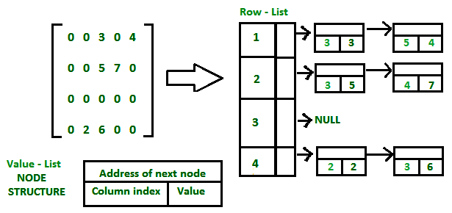
Linked list of lists Application – Sparse matrix
To represent sparse matrix, we could use linked list of lists which consists two lists:
one list is used to represent the rows and each row contains the list of triples: Column index, Value(non – zero element) and address field, for non – zero elements.
For the best performance both lists should be stored in order of ascending keys.
// Node to represent triples
typdedef struct
{
int column_index;
int value;
struct value_list *next;
}value_list;
typedef struct
{
int row_number;
struct row_list *link_down;
struct value_list *link_right;
} row_list;
Notes:
struct row_list
{
int row_number;
struct row_list *link_down;
struct value_list *link_right;
};
// Node to represent triples
struct value_list
{
int column_index;
int value;
struct value_list *next;
};

Slide 112
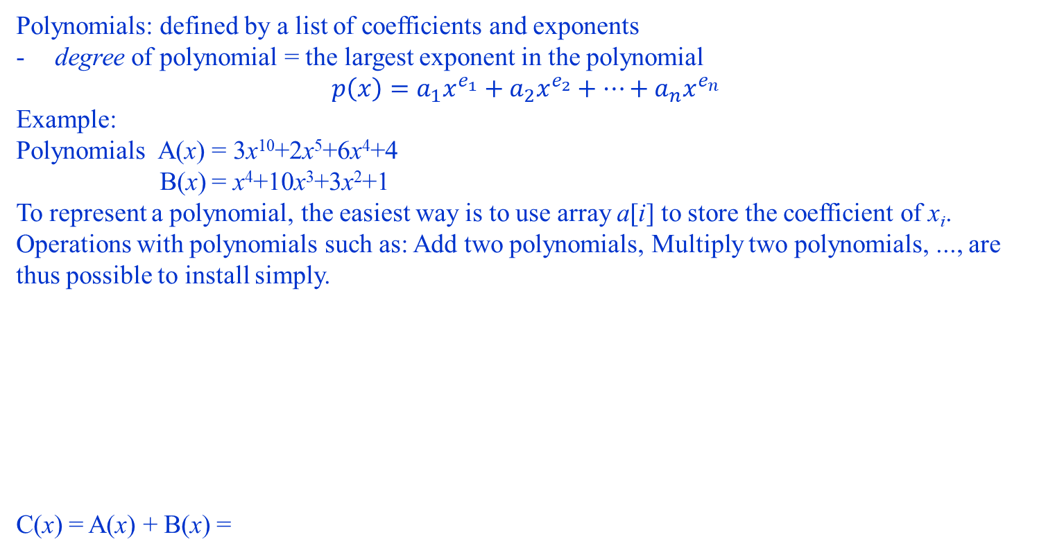
Exercise: Polynomial Addition
Polynomials: defined by a list of coefficients and exponents
degree of polynomial = the largest exponent in the polynomial
$$p\left(x\right)=a_{1}x^{e_{1}}+a_{2}x^{e_{2}}+…+a_{n}x^{e_{n}}$$
Example:
Polynomials A(x) = 3x¹⁰+2x⁵+6x⁴+4
B(x) = x⁴+10x³+3x²+1
To represent a polynomial, the easiest way is to use array a[i] to store the coefficient of x_{i}. Operations with polynomials such as: Add two polynomials, Multiply two polynomials, ..., are thus possible to install simply.
C(x) = A(x) + B(x) =
Array a ~A(x) | a[10] | a[9] | a[8] | a[7] | a[6] | a[5] | a[4] | a[3] | a[2] | a[1] | a[0]
 | 3 | 0 | 0 | 0 | 0 | 2 | 6 | 0 | 0 | 0 | 4
Array b ~B(x) | b[4] | b[3] | b[2] | b[1] | b[0]
 | 1 | 10 | 3 | 0 | 1
3x¹⁰+2x⁵+7x⁴+3x²+5
Array c ~C(x) | c[10] | c[9] | c[8] | c[7] | c[6] | c[5] | c[4] | c[3] | c[2] | c[1] | c[0]
 | =a[10] =3 | =a[9] =0 | =a[8]=0 | =a[7]=0 | =a[6] =0 | =a[5] =2 | =a[4]+b[4] =6+1=7 | =a[3]+b[3] =0+10=10 | =a[2]+b[2] =0+3=3 | =a[1]+b[1] =0+0=0 | =a[0]+b[0] =4+1=5

Slide 113
Exercise: Polynomial Addition
A(x)=2x¹⁰⁰⁰ + x³
B(x)=x⁴+10x³+3x²+1
Use an array to keep track of the coefficients for all exponents:
A(x) + B(x) =
In the case of sparse polynomial (with many coefficients equal to 0), we could represent polynomial by the linked list: We will build a list containing only the coefficients with the value not equal to zero together with the exponent.
However, it is more complicated to implement the operations.
A
B
advantage: easy implementation
disadvantage: waste space when sparse

Slide 114
Exercise: Polynomial Addition
A(x)=2x¹⁰⁰⁰ + x³
B(x)=x⁴ + 10x³ + 3x² + 4
Use the linked list to keep track of the coefficients with values ≠ 0 and the exponent:
Poly1
2
1000
1
3
NULL
1
4
10
3
3
2
4
0
NULL
Poly2
typedef struct {
int coef;
int exp;
struct Polynom *next;
} Polynom;
Polynom *Poly1, *Poly2;

Slide 115
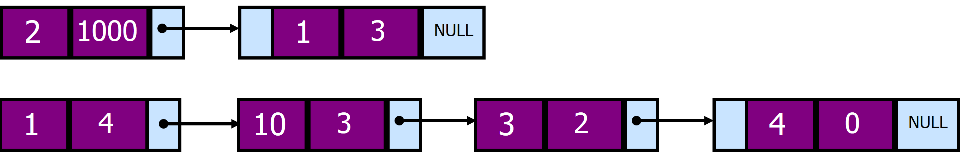
Polynom *PolySum, *node,*ptr,*ptr1,*ptr2;
node = (Polynom *) malloc (sizeof(Polynom));
PolySum = node;
ptr1 = Poly1; ptr2 = Poly2;
while (ptr1!=NULL && ptr2!=NULL){
ptr = node;
if (ptr1->exp < ptr2->exp ) {
node->coef = ptr2->coef;
node->exp = ptr2->exp;
ptr2 = ptr2->next; //update ptr list 2
}
else if ( ptr1->exp > ptr2->exp )
{ node->coef = ptr1->coef;
node->exp = ptr1->exp;
ptr1 = ptr1->next; //update ptr list 1
}
else
{ node->coef = ptr2->coef + ptr1->coef;
node->exp = ptr2->exp;
ptr1 = ptr1->next; //update ptr list 1
ptr2 = ptr2->next; //update ptr list 2
}
node = (Polynom *) malloc (sizeof(Polynom));
ptr->nextp = node; //update ptr listResult
} //end of while
Ptr1
Ptr2
ptr

Slide 116
if (ptr1 == NULL) //end of list 1
{
while(ptr2!= NULL) //copy the remaining of list2 to listResult
{ node->coef = ptr2->coef;
node->exp = ptr2->exp;
ptr2 = ptr2->next; //update ptr list 2
ptr = node;
node = (Polynom *) malloc (sizeof(Polynom));
ptr->next = node; //update ptr listResult
}
}
else if (ptr2==NULL) //end of list 2
{
while(ptr1 != NULL) //copy the remaining of list1 to the listResult
{ node->coef = ptr1->coef;
node->exp = ptr1->exp;
ptr1 = ptr1->next; //update ptr list 2
ptr = node;
node = (TPol *)malloc (sizeof(TPol));
ptr->next = node; //update ptr listResult
}
}
ptr->next = NULL;
}

Slide 117
Polynom *PolySum, *node,*ptr,*ptr1,*ptr2;
node = (Polynom *) malloc (sizeof(Polynom));
PolySum = node;
ptr1 = Poly1; ptr2 = Poly2;
while (ptr1!=NULL && ptr2!=NULL){
ptr = node;
if (ptr1->exp < ptr2->exp ) {
node->coef = ptr2->coef;
node->exp = ptr2->exp;
ptr2 = ptr2->next; //update ptr list 2
}
else if ( ptr1->exp > ptr2->exp )
{ node->coef = ptr1->coef;
node->exp = ptr1->exp;
ptr1 = ptr1->next; //update ptr list 1
}
else
{ node->coef = ptr2->coef + ptr1->coef;
node->exp = ptr2->exp;
ptr1 = ptr1->next; //update ptr list 1
ptr2 = ptr2->next; //update ptr list 2
}
node = (Polynom *) malloc (sizeof(Polynom));
ptr->nextp = node; //update ptr listResult
} //end of while
Ptr1
Ptr2
ptr
illustration

Slide 118
Polynom *PolySum, *node,*ptr,*ptr1,*ptr2;
node = (Polynom *) malloc (sizeof(Polynom));
PolySum = node;
ptr1 = Poly1; ptr2 = Poly2;
while (ptr1!=NULL && ptr2!=NULL){
ptr = node;
if (ptr1->exp < ptr2->exp ) {
node->coef = ptr2->coef;
node->exp = ptr2->exp;
ptr2 = ptr2->next; //update ptr list 2
}
else if ( ptr1->exp > ptr2->exp )
{ node->coef = ptr1->coef;
node->exp = ptr1->exp;
ptr1 = ptr1->next; //update ptr list 1
}
else
{ node->coef = ptr2->coef + ptr1->coef;
node->exp = ptr2->exp;
ptr1 = ptr1->next; //update ptr list 1
ptr2 = ptr2->next; //update ptr list 2
}
node = (Polynom *) malloc (sizeof(Polynom));
ptr->next = node; //update ptr listResult
} //end of while
Ptr1
Ptr2
2
1000
ptr
illustration

Slide 119
Polynom *PolySum, *node,*ptr,*ptr1,*ptr2;
node = (Polynom *) malloc (sizeof(Polynom));
PolySum = node;
ptr1 = Poly1; ptr2 = Poly2;
while (ptr1!=NULL && ptr2!=NULL){
ptr = node;
if (ptr1->exp < ptr2->exp ) {
node->coef = ptr2->coef;
node->exp = ptr2->exp;
ptr2 = ptr2->next; //update ptr list 2
}
else if ( ptr1->exp > ptr2->exp )
{ node->coef = ptr1->coef;
node->exp = ptr1->exp;
ptr1 = ptr1->next; //update ptr list 1
}
else
{ node->coef = ptr2->coef + ptr1->coef;
node->exp = ptr2->exp;
ptr1 = ptr1->next; //update ptr list 1
ptr2 = ptr2->next; //update ptr list 2
}
node = (Polynom *) malloc (sizeof(Polynom));
ptr->next = node; //update ptr listResult
} //end of while
Ptr1
Ptr2
2
1000
ptr
illustration

Slide 120
Polynom *PolySum, *node,*ptr,*ptr1,*ptr2;
node = (Polynom *) malloc (sizeof(Polynom));
PolySum = node;
ptr1 = Poly1; ptr2 = Poly2;
while (ptr1!=NULL && ptr2!=NULL){
ptr = node;
if (ptr1->exp < ptr2->exp ) {
node->coef = ptr2->coef;
node->exp = ptr2->exp;
ptr2 = ptr2->next; //update ptr list 2
}
else if ( ptr1->exp > ptr2->exp )
{ node->coef = ptr1->coef;
node->exp = ptr1->exp;
ptr1 = ptr1->next; //update ptr list 1
}
else
{ node->coef = ptr2->coef + ptr1->coef;
node->exp = ptr2->exp;
ptr1 = ptr1->next; //update ptr list 1
ptr2 = ptr2->next; //update ptr list 2
}
node = (Polynom *) malloc (sizeof(Polynom));
ptr->next = node; //update ptr listResult
} //end of while
Ptr1
Ptr2
2
1000
ptr
illustration

Slide 121
Polynom *PolySum, *node,*ptr,*ptr1,*ptr2;
node = (Polynom *) malloc (sizeof(Polynom));
PolySum = node;
ptr1 = Poly1; ptr2 = Poly2;
while (ptr1!=NULL && ptr2!=NULL){
ptr = node;
if (ptr1->exp < ptr2->exp ) {
node->coef = ptr2->coef;
node->exp = ptr2->exp;
ptr2 = ptr2->next; //update ptr list 2
}
else if ( ptr1->exp > ptr2->exp )
{ node->coef = ptr1->coef;
node->exp = ptr1->exp;
ptr1 = ptr1->next; //update ptr list 1
}
else
{ node->coef = ptr2->coef + ptr1->coef;
node->exp = ptr2->exp;
ptr1 = ptr1->next; //update ptr list 1
ptr2 = ptr2->next; //update ptr list 2
}
node = (Polynom *) malloc (sizeof(Polynom));
ptr->next = node; //update ptr listResult
} //end of while
Ptr1
Ptr2
2
1000
1
4
ptr
illustration

Slide 122
Polynom *PolySum, *node,*ptr,*ptr1,*ptr2;
node = (Polynom *) malloc (sizeof(Polynom));
PolySum = node;
ptr1 = Poly1; ptr2 = Poly2;
while (ptr1!=NULL && ptr2!=NULL){
ptr = node;
if (ptr1->exp < ptr2->exp ) {
node->coef = ptr2->coef;
node->exp = ptr2->exp;
ptr2 = ptr2->next; //update ptr list 2
}
else if ( ptr1->exp > ptr2->exp )
{ node->coef = ptr1->coef;
node->exp = ptr1->exp;
ptr1 = ptr1->next; //update ptr list 1
}
else
{ node->coef = ptr2->coef + ptr1->coef;
node->exp = ptr2->exp;
ptr1 = ptr1->next; //update ptr list 1
ptr2 = ptr2->next; //update ptr list 2
}
node = (Polynom *) malloc (sizeof(Polynom));
ptr->next = node; //update ptr listResult
} //end of while
Ptr1
Ptr2
2
1000
1
4
ptr
illustration

Slide 123
Polynom *PolySum, *node,*ptr,*ptr1,*ptr2;
node = (Polynom *) malloc (sizeof(Polynom));
PolySum = node;
ptr1 = Poly1; ptr2 = Poly2;
while (ptr1!=NULL && ptr2!=NULL){
ptr = node;
if (ptr1->exp < ptr2->exp ) {
node->coef = ptr2->coef;
node->exp = ptr2->exp;
ptr2 = ptr2->next; //update ptr list 2
}
else if ( ptr1->exp > ptr2->exp )
{ node->coef = ptr1->coef;
node->exp = ptr1->exp;
ptr1 = ptr1->next; //update ptr list 1
}
else
{ node->coef = ptr2->coef + ptr1->coef;
node->exp = ptr2->exp;
ptr1 = ptr1->next; //update ptr list 1
ptr2 = ptr2->next; //update ptr list 2
}
node = (Polynom *) malloc (sizeof(Polynom));
ptr->next = node; //update ptr listResult
} //end of while
Ptr1
Ptr2
2
1000
1
4
ptr
illustration

Slide 124
Polynom *PolySum, *node,*ptr,*ptr1,*ptr2;
node = (Polynom *) malloc (sizeof(Polynom));
PolySum = node;
ptr1 = Poly1; ptr2 = Poly2;
while (ptr1!=NULL && ptr2!=NULL){
ptr = node;
if (ptr1->exp < ptr2->exp ) {
node->coef = ptr2->coef;
node->exp = ptr2->exp;
ptr2 = ptr2->next; //update ptr list 2
}
else if ( ptr1->exp > ptr2->exp )
{ node->coef = ptr1->coef;
node->exp = ptr1->exp;
ptr1 = ptr1->next; //update ptr list 1
}
else
{ node->coef = ptr2->coef + ptr1->coef;
node->exp = ptr2->exp;
ptr1 = ptr1->next; //update ptr list 1
ptr2 = ptr2->next; //update ptr list 2
}
node = (Polynom *) malloc (sizeof(Polynom));
ptr->next = node; //update ptr listResult
} //end of while
Ptr1
Ptr2
2
1000
1
4
11
3
ptr
illustration

Slide 125
Polynom *PolySum, *node,*ptr,*ptr1,*ptr2;
node = (Polynom *) malloc (sizeof(Polynom));
PolySum = node;
ptr1 = Poly1; ptr2 = Poly2;
while (ptr1!=NULL && ptr2!=NULL){
ptr = node;
if (ptr1->exp < ptr2->exp ) {
node->coef = ptr2->coef;
node->exp = ptr2->exp;
ptr2 = ptr2->next; //update ptr list 2
}
else if ( ptr1->exp > ptr2->exp )
{ node->coef = ptr1->coef;
node->exp = ptr1->exp;
ptr1 = ptr1->next; //update ptr list 1
}
else
{ node->coef = ptr2->coef + ptr1->coef;
node->exp = ptr2->exp;
ptr1 = ptr1->next; //update ptr list 1
ptr2 = ptr2->next; //update ptr list 2
}
node = (Polynom *) malloc (sizeof(Polynom));
ptr->next = node; //update ptr listResult
} //end of while
Ptr1
Ptr2
2
1000
1
4
11
3
ptr
illustration

Slide 126
Polynom *PolySum, *node,*ptr,*ptr1,*ptr2;
node = (Polynom *) malloc (sizeof(Polynom));
PolySum = node;
ptr1 = Poly1; ptr2 = Poly2;
while (ptr1!=NULL && ptr2!=NULL){
ptr = node;
if (ptr1->exp < ptr2->exp ) {
node->coef = ptr2->coef;
node->exp = ptr2->exp;
ptr2 = ptr2->next; //update ptr list 2
}
else if ( ptr1->exp > ptr2->exp )
{ node->coef = ptr1->coef;
node->exp = ptr1->exp;
ptr1 = ptr1->next; //update ptr list 1
}
else
{ node->coef = ptr2->coef + ptr1->coef;
node->exp = ptr2->exp;
ptr1 = ptr1->next; //update ptr list 1
ptr2 = ptr2->next; //update ptr list 2
}
node = (Polynom *) malloc (sizeof(Polynom));
ptr->next = node; //update ptr listResult
} //end of while
Ptr1
Ptr2
2
1000
1
4
11
3
ptr
illustration

Slide 127
if (ptr1 == NULL) //end of list 1
{ while(ptr2!= NULL) //copy the remaining of list2 to listResult
{ node->coef = ptr2->coef;
node->exp = ptr2->exp;
ptr2 = ptr2->next; //update ptr list 2
ptr = node;
node = (Polynom *) malloc (sizeof(Polynom));
ptr->next = node; //update ptr listResult
}
}
else if (ptr2==NULL) //end of list 2
{
while(ptr1 != NULL) //copy the remaining of list1 to the listResult
{ node->coef = ptr1->coef;
node->exp = ptr1->exp;
ptr1 = ptr1->next; //update ptr list 2
ptr = node;
node = (Polynom *)malloc (sizeof(Polynom));
ptr->next = node; //update ptr listResult
}
}
ptr->next = NULL;
}
Ptr1
Ptr2
2
1000
1
4
11
3
ptr
3
2
illustration

Slide 128
if (ptr1 == NULL) //end of list 1
{ while(ptr2!= NULL) //copy the remaining of list2 to listResult
{ node->coef = ptr2->coef;
node->exp = ptr2->exp;
ptr2 = ptr2->next; //update ptr list 2
ptr = node;
node = (Polynom *) malloc (sizeof(Polynom));
ptr->next = node; //update ptr listResult
}
}
else if (ptr2==NULL) //end of list 2
{
while(ptr1 != NULL) //copy the remaining of list1 to the listResult
{ node->coef = ptr1->coef;
node->exp = ptr1->exp;
ptr1 = ptr1->next; //update ptr list 2
ptr = node;
node = (Polynom *)malloc (sizeof(Polynom));
ptr->next = node; //update ptr listResult
}
}
ptr->next = NULL;
}
Ptr1
Ptr2
2
1000
1
4
11
3
ptr
3
2
illustration

Slide 129
if (ptr1 == NULL) //end of list 1
{ while(ptr2!= NULL) //copy the remaining of list2 to listResult
{ node->coef = ptr2->coef;
node->exp = ptr2->exp;
ptr2 = ptr2->next; //update ptr list 2
ptr = node;
node = (Polynom *) malloc (sizeof(Polynom));
ptr->next = node; //update ptr listResult
}
}
else if (ptr2==NULL) //end of list 2
{
while(ptr1 != NULL) //copy the remaining of list1 to the listResult
{ node->coef = ptr1->coef;
node->exp = ptr1->exp;
ptr1 = ptr1->next; //update ptr list 2
ptr = node;
node = (Polynom *)malloc (sizeof(Polynom));
ptr->next = node; //update ptr listResult
}
}
ptr->next = NULL;
}
Ptr1
Ptr2
2
1000
1
4
11
3
3
2
ptr
illustration

Slide 130
if (ptr1 == NULL) //end of list 1
{ while(ptr2!= NULL) //copy the remaining of list2 to listResult
{ node->coef = ptr2->coef;
node->exp = ptr2->exp;
ptr2 = ptr2->next; //update ptr list 2
ptr = node;
node = (Polynom *) malloc (sizeof(Polynom));
ptr->next = node; //update ptr listResult
}
}
else if (ptr2==NULL) //end of list 2
{
while(ptr1 != NULL) //copy the remaining of list1 to the listResult
{ node->coef = ptr1->coef;
node->exp = ptr1->exp;
ptr1 = ptr1->next; //update ptr list 2
ptr = node;
node = (Polynom *)malloc (sizeof(Polynom));
ptr->next = node; //update ptr listResult
}
}
ptr->next = NULL;
}
Ptr1
Ptr2
2
1000
1
4
11
3
3
2
ptr
4
0
illustration

Slide 131
if (ptr1 == NULL) //end of list 1
{ while(ptr2!= NULL) //copy the remaining of list2 to listResult
{ node->coef = ptr2->coef;
node->exp = ptr2->exp;
ptr2 = ptr2->next; //update ptr list 2
ptr = node;
node = (Polynom *) malloc (sizeof(Polynom));
ptr->next = node; //update ptr listResult
}
}
else if (ptr2==NULL) //end of list 2
{
while(ptr1 != NULL) //copy the remaining of list1 to the listResult
{ node->coef = ptr1->coef;
node->exp = ptr1->exp;
ptr1 = ptr1->next; //update ptr list 2
ptr = node;
node = (Polynom *)malloc (sizeof(Polynom));
ptr->next = node; //update ptr listResult
}
}
ptr->next = NULL;
}
Ptr1
Ptr2
2
1000
1
4
11
3
3
2
4
0
ptr
NULL
A(x) = 2x¹⁰⁰⁰ + x³
B(x) = x⁴ + 10x³ + 3x² + 4
Result(x) = 2x¹⁰⁰⁰ + x⁴ + 11x³ + 3x² + 4

Slide 132
Contents
2.1. Array
2.2. Record
2.3. Linked List
2.4. Stack
2.5. Queue

Slide 133
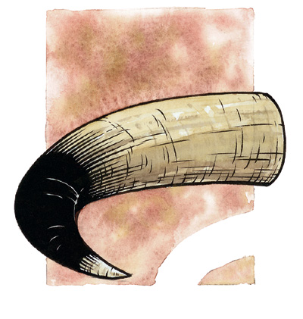





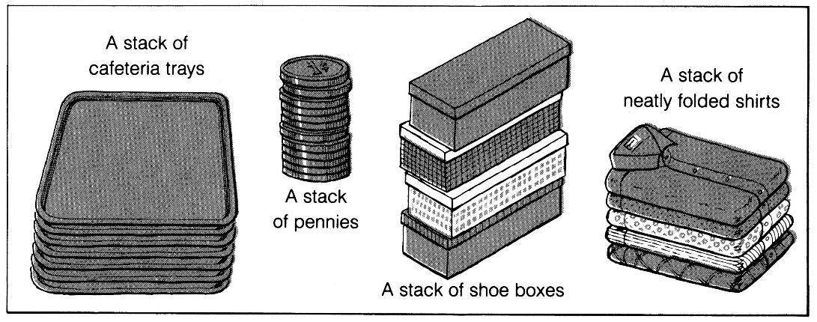
What is a stack?
A stack is a data structure that only allows items to be inserted and removed at one end
We call this end the top of the stack
The other end is called the bottom
Access to other items in the stack is not allowed
The last element to be added is the first to be removed (LIFO: Last In, First Out)

Slide 134
Operation on stack
Push: the operation to place a new item at the top of the stack
Pop: the operation to remove the next item from the top of the stack
M
C
C
C
R
push(M)
R
item = pop()
item = M
R
X
X
X
A
A
A

Slide 135
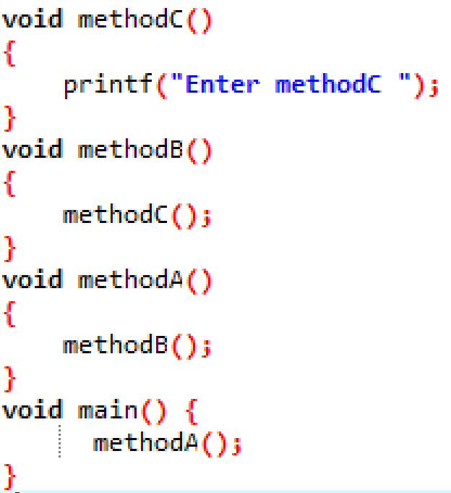
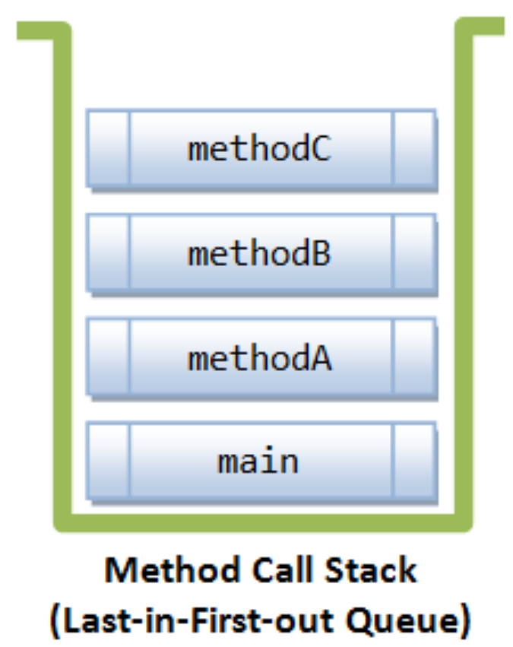
What Are Stacks Used For?
Real life (Pile of books, Plate trays, etc.)
More applications related to computer science
Program execution stack: Most programming languages use a “call stack” to implement function calling
When a method is called, its line number and other useful information are pushed (inserted) on the call stack
When a method ends, it is popped (removed) from the call stack and execution restarts at the indicated line number in the method that is now at the top of the stack
Evaluating expressions (e.g. (4/(2-2+3))*(3-4)*2)
main pushed onto call stack, before invoking methodA
methodA pushed onto call stack, before invoking methodB
methodB pushed onto call stack, before invoking methodC
methodC pushed onto call stack, invoked then popped out from the call stack when completes
methodB popped out from call stack when completes.
methodA popped out from the call stack when completes.
main popped out from the call stack when completes. Program exits.
Notes:
main() pushed onto call stack, before invoking methodA().
methodA() pushed onto call stack, before invoking methodB().
methodB() pushed onto call stack, before invoking methodC().
methodC() completes.
methodB() popped out from call stack and completes.
methodA() popped out from the call stack and completes.
main() popped out from the call stack and completes. Program exits.

Slide 136
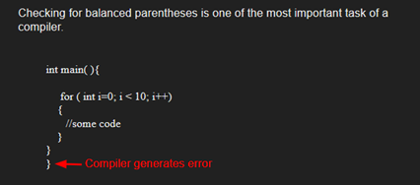
What Are Stacks Used For?
More applications related to computer science
compilers
parsing data between delimiters (brackets)
Check: each “(”, “{”, or “[” has to pair with “)”, “}”, or “]”
Example:
correct: ( )(( )){([( )])}
correct: ((( )(( )){([( )])}
incorrect: )(( )){([( )])}
incorrect: ({[ ])}
incorrect: (
virtual machines
manipulating numbers
pop 2 numbers off stack, do work (such as add)
push result back on stack and repeat
artificial intelligence
finding a path
Notes:
Parentheses /pơ ren thơ si/

Slide 137
Example: Reversing a Word
We can use a stack to reverse the letters in a word.
How?
Example: READ
Push(R)
Push(E)
Push(A)
D
Push(D)
A
Read each letter in the word and push it onto the stack
E
R

Slide 138
Example: Reversing a Word
We can use a stack to reverse the letters in a word.
How?
Example: READ
Push(R)
Pop(D)
D
A
E
R
Push(E)
Pop(A)
Push(A)
Pop(E)
D
Push(D)
Pop(R)
A
Read each letter in the word and push it onto the stack
When you reach the end of the word, pop the letters off the stack and print them out
E
R

Slide 139
Recursive factorial
factorial(6)
if (n <= 1) return 1
else
return 6 * factorial(5)
factorial(5)
if (n <= 1) return 1
else
return 5 * factorial(4)
factorial(4)
if (n <= 1) return 1
else
return 4* factorial(3)
factorial(3)
if (n <= 1) return 1
else
return 3* factorial(2)
factorial(2)
if (n <= 1) return 1
else
return 2 * factorial(1)
factorial(1)
if (n <= 1) return 1
else
return 1 * factorial(0)

Slide 140
Execution of recursive factorial
factorial(6)
if (n <= 1) return 1
else
return 6 * factorial(5)
factorial(6)
if (n <= 1) return 1
else
return 6 * factorial(5)
factorial(1)
if (n <= 1) return 1
else
return 1 * factorial(0)
factorial(5)
if (n <= 1) return 1
else
return 5 * factorial(4)
factorial(5)
if (n <= 1) return 1
else
return 5 * factorial(4)
factorial(2)
if (n <= 1) return 1
else
return 2 * factorial(1)
factorial(4)
if (n <= 1) return 1
else
return 4* factorial(3)
factorial(4)
if (n <= 1) return 1
else
return 4* factorial(3)
factorial(3)
if (n <= 1) return 1
else
return 3* factorial(2)
factorial(3)
if (n <= 1) return 1
else
return 3* factorial(2)
factorial(3)
if (n <= 1) return 1
else
return 3* factorial(2)
factorial(4)
if (n <= 1) return 1
else
return 4* factorial(3)
factorial(2)
if (n <= 1) return 1
else
return 2 * factorial(1)
factorial(2)
if (n <= 1) return 1
else
return 2 * factorial(1)
factorial(5)
if (n <= 1) return 1
else
return 5 * factorial(4)
factorial(1)
if (n <= 1) return 1
else
return 1 * factorial(0)
factorial(1)
if (n <= 1) return 1
else
return 1 * factorial(0)
factorial(6)
if (n <= 1) return 1
else
return 6 * factorial(5)

Slide 141
factorial(6)
if (n <= 1) return 1
else
return 6 * factorial(5)
factorial(1)
if (n <= 1) return 1
else
return 1 * factorial(0)
factorial(5)
if (n <= 1) return 1
else
return 5 * factorial(4)
factorial(2)
if (n <= 1) return 1
else
return 2 * factorial(1)
factorial(4)
if (n <= 1) return 1
else
return 4* factorial(3)
factorial(3)
if (n <= 1) return 1
else
return 3* factorial(2)
factorial(3)
if (n <= 1) return 1
else
return 3* factorial(2)
factorial(4)
if (n <= 1) return 1
else
return 4* factorial(3)
factorial(2)
if (n <= 1) return 1
else
return 2 * factorial(1)
factorial(5)
if (n <= 1) return 1
else
return 5 * factorial(4)
factorial(1)
if (n <= 1) return 1
else
return 1 * factorial(0)
factorial(6)
if (n <= 1) return 1
else
return 6 * factorial(5)

Slide 142
factorial(6)
if (n <= 1) return 1
else
return 6 * factorial(5)
factorial(5)
if (n <= 1) return 1
else
return 5 * factorial(4)
factorial(2)
if (n <= 1) return 1
else
return 2 * factorial(1)
factorial(4)
if (n <= 1) return 1
else
return 4* factorial(3)
factorial(3)
if (n <= 1) return 1
else
return 3* factorial(2)
factorial(3)
if (n <= 1) return 1
else
return 3* factorial(2)
factorial(4)
if (n <= 1) return 1
else
return 4* factorial(3)
factorial(2)
if (n <= 1) return 1
else
return 2 * factorial(1)
factorial(5)
if (n <= 1) return 1
else
return 5 * factorial(4)
factorial(6)
if (n <= 1) return 1
else
return 6 * factorial(5)

Slide 143
factorial(6)
if (n <= 1) return 1
else
return 6 * factorial(5)
factorial(5)
if (n <= 1) return 1
else
return 5 * factorial(4)
factorial(4)
if (n <= 1) return 1
else
return 4* factorial(3)
factorial(3)
if (n <= 1) return 1
else
return 3* factorial(2)
factorial(3)
if (n <= 1) return 1
else
return 3* factorial(2)
factorial(4)
if (n <= 1) return 1
else
return 4* factorial(3)
factorial(5)
if (n <= 1) return 1
else
return 5 * factorial(4)
factorial(6)
if (n <= 1) return 1
else
return 6 * factorial(5)

Slide 144
Implementing a Stack
At least two different ways to implement a stack
array
linked list
Which method to use depends on the application
what advantages and disadvantages does each implementation have?

Slide 145
Stack: Array Implementation
If an array is used to implement a stack what is a good index for the top item?
Is it position 0?
Is it position numItems-1?
Note that push and pop must both work in O(1) time as stacks are usually assumed to be extremely fast
Implementing a stack using an array is fairly easy:
The bottom of the stack is at S[0]
The top of the stack is at S[numItems-1]
push onto the stack at S[numItems]
pop off of the stack at S[numItems-1]
…
S
0
1
2
numItems
N

Slide 146
Stack: Array Implementation
Basic operations:
void STACKinit(int);
int STACKempty();
void STACKpush(Item);
Item STACKpop();
typedef .... Item;
static Item *s;
static int maxSize;//maximum number of elements that the stack could have
static int numItems; //current number of elements on stack
void STACKinit(int maxSize)
{
s = (Item *) malloc(maxSize*sizeof(Item));
N = 0;
}
int STACKempty(){return numItems==0;}
int STACKfull() {return numItems==maxSize;}
void STACKpush(Item item)
{
if (Stackfull()) ERROR(“Stack is full”);
else
{ s[numItems] = item;
numItems++;
}
}
Item STACKpop()
{
if (STACKempty()) ERROR(“Stack is empty”)
else
{
numItems--;
return s[numItems+1];
}
}

Slide 147
Array Implementation Summary
Advantages
Easy to implement
best performance: push and pop can be performed in O(1) time
Disadvantage
fixed size: the size of the array must be initially specified because
The array size must be known when the array is created and is fixed, so that the right amount of memory can be reserved
Once the array is full no new items can be inserted
If the maximum size of the stack is not known (or is much larger than the expected size) a dynamic array can be used
But occasionally push will take O(n) time
…
S
0
1
2
numItems
maxSize
maxSize: maximum number of elements in the array

Slide 148
Stack overflow
The condition resulting from trying to push an element onto a full stack.
if(STACKfull())
STACKpush(item);
Stack underflow
The condition resulting from trying to pop an empty stack.
if (STACKempty())
STACKpop(item);

Slide 149
Implementing a Stack: using linked list
Store the items in the stack in a linked list
The top of the stack is the head node, the bottom of the stack is the end of the list
push by adding to the front of the list
pop by removing from the front of the list
4.1
2.4
8.9
2.3
NULL
top
3.3
3.3
4.1
2.4
8.9
2.3
NULL
4.1
2.4
top
typedef struct {
float item;
struct StackNode *next;
} StackNode;
typedef struct {
StackNode *top;
}Stack;
8.9
2.3

Slide 150
Implementing a Stack: using linked list
Store the items in the stack in a linked list
The top of the stack is the head node, the bottom of the stack is the end of the list
push by adding to the front of the list
pop by removing from the front of the list
4.1
2.4
8.9
2.3
NULL
top
3.3
3.3
4.1
2.4
8.9
2.3
NULL
4.1
2.4
top
8.9
2.3

Slide 151
Operations
1. Init:
Stack *StackConstruct();
2. Check empty:
int StackEmpty(Stack* s);
3. Check full:
int StackFull(Stack* s);
4. Insert a new item into stack (Push): insert a new item at the top of stack
int StackPush(Stack* s, float* item);
5. Remove an item from stack (Pop): remove and return the item at the top of stack: float pop(Stack* s);
6. Print out all items of stack
void Disp(Stack* s);

Slide 152
Initialize stack
Stack *StackConstruct() {
Stack *s;
s = (Stack *)malloc(sizeof(Stack));
if (s == NULL) {
return NULL; // No memory
}
s->top = NULL;
return s;
}
/**** Destroy stack *****/
void StackDestroy(Stack *s) {
while (!StackEmpty(s)) {
StackPop(s);
}
free(s);
}
152

Slide 153
/*** Check empty ***/
int StackEmpty(const Stack *s) {
return (s->top == NULL);
}
/*** Check full ***/
int StackFull() {
printf("\n NO MEMORY! STACK IS FULL");
return 1;
}

Slide 154
Display all items in the stack
void disp(Stack* s) {
StackNode* node;
int ct = 0; float m;
printf("\n\n List of all items in the stack \n\n");
if (StackEmpty(s))
printf("\n\n >>>>> EMPTY STACK <<<<<\n");
else {
node = s->top;
do {
m = node->item;
printf("%8.3f \n", m);
node = node->next;
} while (!(node == NULL));
}
}

Slide 155
Push
Need to do the following steps:
Create new node: allocate memory and assign data for new node
Link this new node to the top (head) node
(3) Assign this new node as top (head) node
int StackPush(Stack *s, float item) {
StackNode *node;
node = (StackNode *)malloc(sizeof(StackNode)); //(1)
if (node == NULL) {
StackFull(); return 1; // overflow: out of memory
}
node->item = item; //(1)
node->next = s->top; //(2)
s->top = node; //(3)
return 0;
}

Slide 156
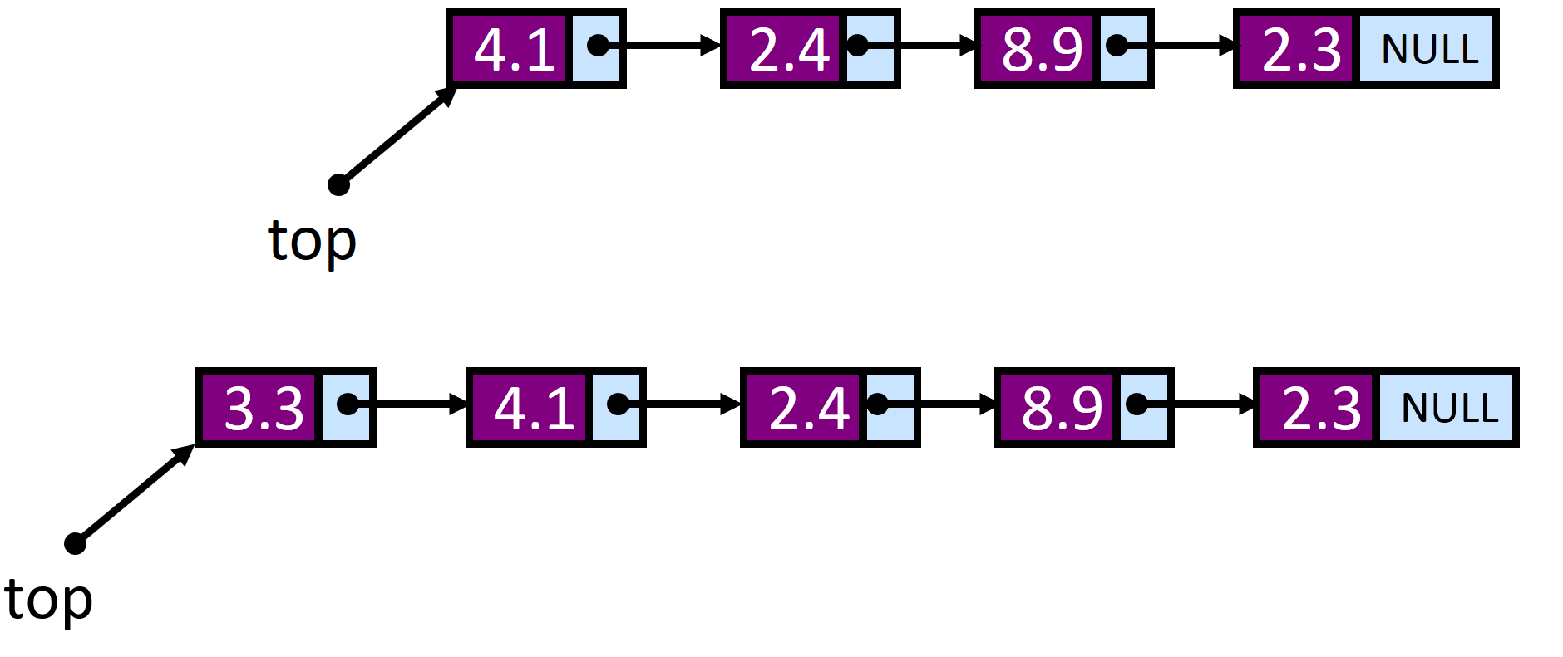
Pop
Check whether the stack is empty
Memorize address of the current top (head) node
Memorize data of the current top (head) node
Update the top (head) node: the top (head) node now points to its next node
Free the old top (head) node
Return data of the old top (head) node
float StackPop(Stack *s) {
float data;
StackNode *node;
if (StackEmpty(s)) //(1)
return NULL; // Empty Stack, can't pop
node = s->top; //(2)
data = node->item; //(3)
s->top = node->next; //(4)
free(node); //(5)
return item; //(6)
}

Slide 157
Experimental program
#include <stdio.h>
#include <conio.h>
#include <stdlib.h>
#include <alloc.h>
// all above functions of stacks are put here
int main() {
int ch,n,i; float m;
Stack* stackPtr;
while(1)
{ printf("\n\n======================\n");
printf(“ STACK TEST PROGRAM \n");
printf("======================\n");
printf(" 1.Create\n 2.Push\n 3.Pop\n 4.Display\n 5.Exit\n");
printf("----------------------\n");
printf(“Input number to select the appropriate operation: ");
scanf("%d",&ch); printf("\n\n");

Slide 158
switch(ch) {
case 1: printf(“INIT STACK");
stackPtr = StackConstruct(); break;
case 2: printf(“Input float number to insert into stack: ");
scanf("%f",&m);
StackPush(stackPtr, m); break;
case 3: m=StackPop(stackPtr);
if (m != NULL)
printf("\n Data Value of the popped node: %8.3f\n",m);
else {
printf("\n >>> Empty Stack, can't pop <<<\n");}
break;
case 4: disp(stackPtr); break;
case 5: printf("\n Bye! Bye! \n\n");
exit(0); break;
default: printf("Wrong choice");
} //switch
} // end while
} //end main

Slide 159
Implementing a Stack: using linked list
Advantages:
always constant time to push or pop an element
can grow to an infinite size
Disadvantages
Difficult to implement

Slide 160
Application 1: Parentheses Matching
Check for balanced parentheses in an expression:
Given an expression, write a program to examine whether the pairs match and the order is correct of “{“,”}”,”(“,”)”,”[“,”]”.
For example, the program should print true for expression = “[()]{}{[()()]()}” and false for expression = “[(])”
Algorithm: 1) Declare a character stack S. 2) Now traverse the string expression a) If the current character is a starting bracket (‘(‘ or ‘{‘ or ‘[‘) then push it to stack. b) If the current character is a closing bracket (‘)’ or ‘}’ or ‘]’) then pop from stack and if the popped character is the matching starting bracket then fine else parenthesis are not balanced. 3) After complete traversal, if there is some starting bracket left in stack then “not balanced”

Slide 161
Application 1: Parentheses Matching
Algorithm ParenMatch(X,n):
Input: Array X consists of n characters, each character could be either parentheses, variable, arithmetic operation, number.
Output: true if parentheses in an expression are balanced
S = stack empty;
for i=0 to n-1 do
if (X[i] is a starting bracket)
push(S, X[i]); // starting bracket (‘(‘ or ‘{‘ or ‘[‘) then push it to stack else
if (X[i] is a closing bracket) // compare X[i] with the one currently on the top of stack
if isEmpty(S)
return false {can not find pair of brackets}
if (pop(S) not pair with bracket stored in X[i])
return false {error: type of brackets}
if isEmpty(S)
return true {parentheses are balanced}
else return false {there exist a bracket not paired}

Slide 162
Application 2: HTML Tag Matching
In HTML, each <name> has to pair with </name>
<body>
<center>
<h1> The Little Boat </h1>
</center>
<p> The storm tossed the little
boat like a cheap sneaker in an
old washing machine. The three
drunken fishermen were used to
such treatment, of course, but
not the tree salesman, who even as
a stowaway now felt that he
had overpaid for the voyage. </p>
<ol>
<li> Will the salesman die? </li>
<li> What color is the boat? </li>
<li> And what about Naomi? </li>
</ol>
</body>
The Little Boat
The storm tossed the little boat
like a cheap sneaker in an old
washing machine. The three
drunken fishermen were used to
such treatment, of course, but not
the tree salesman, who even as
a stowaway now felt that he had
overpaid for the voyage.
1. Will the salesman die?
2. What color is the boat?
3. And what about Naomi?

Slide 163
Application 3: Finding a Path using stack
Consider the following graph of flights
: city
Z
flight goes from W to S
Y
W
S
W
S
R
P
T
X
Q

Slide 164
Application 3: Finding a Path using stack
If it exists, we can find a path from any city C₁ to another city C₂ using a stack
place the starting city on the bottom of the stack
mark it as visited
pick any arbitrary arrow out of the city
city cannot be marked as visited
place that city on the stack
also mark it as visited
if that’s the destination, we’re done
otherwise, pick an arrow out of the city currently at
next city must not have been visited before
if there are no legitimate arrows out, pop it off the stack and go back to the previous city
repeat this process until the destination is found or all the cities have been visited

Slide 165
Application 3: Finding a Path using stack
Consider the following graph of flights
: city
Z
flight goes from W to S
Y
W
S
Want to go from P to Y
push P on the stack and mark it as visited
pick R as the next city to visit (random select)
push it on the stack and mark it as visited
pick X as the next city to visit (only choice)
push it on the stack and mark it as visited
no available arrows out of X – pop it
no more available arrows from R – pop it
pick W as next city to visit (only choice left)
push it on the stack and mark it as visited
pick Y as next city to visit (random select)
this is the destination – all done
W
S
R
P
T
X
Q

Slide 166
Contents
2.1. Array
2.2. Record
2.3. Linked List
2.4. Stack
2.5. Queue

Slide 167

What is a Queue?

Slide 168
Queues
What is a queue?
A data structure of ordered items such that items can be inserted only at one end and removed at the other end.
Example: A line at the supermarket
What can we do with a queue?
Enqueue - Add an item to the queue
Dequeue - Remove an item from the queue
These operations are also called insert and getFront in order to simplify things.
A queue is called a FIFO (First in-First out) data structure.
Back/rear/tail
Queue
Front/head
Elements enter
4
3
2
1
Elements exit
no changes of order
Add/
Enqueue
(Remove/Dequeue)
Back/Rear
Front/Head

Slide 169
Queue specification
Definitions: (provided by the user)
maxSize: Max number of items that might be on the queue
ItemType: Data type of the items on the queue
Operations:
Q = init(); initialize empty queue Q
isEmpty(Q); returns "true“ if queue Q is empty
isFull(Q); returns "true“ if Q is full, indicates that we already use the maximum memory for queue; otherwise returns “false”
frontQ(Q); returns the item that is in front (head) of queue Q or returns error if queue Q is empty.
enqueue(Q,x); inserts item x into the back (rear) of queue Q. If before making insertion, the queue Q is full, then give the notification about that.
x = dequeue(Q); deletes the element at the front (head) of the queue Q, then returns x which is the data of this element. If the queue Q is empty before dequeue, then give the error notification.
print(Q); gives the list of all elements in the queue Q in the order from the front to the back.
sizeQ(Q); returns the number of elements currently in the queue Q.

Slide 170
FIFO
Add/
Enqueue
(Remove/Dequeue)
Back/Rear
Front/Head
A
B
A
C
B
A
C
B
E
C
B
rear
front
rear
front
rear
front
rear
front
rear
front
enqueue(Q, A)
enqueue(Q, B)
enqueue(Q, C)
dequeue(Q, A)
enqueue(Q, E)

Slide 171





Queues everywhere!!!!

Slide 172
Queues
What are some applications of queues?
Round-robin scheduling in processors
Input/Output processing
Queueing of packets for delivery in networks

Slide 173
Example
-
Given the sequence of operations on queue Q as following. Determine the output and the data
on the queue Q after each operation:
 | Operation | Output | Queue Q
1 | enqueue(5)
2 | enqueue(Q,3)
3 | dequeue(Q)
4 | enqueue(Q,7)
5 | dequeue(Q)
6 | front(Q)
7 | dequeue(Q)
8 | dequeue(Q)
9 | isEmpty(Q)
10 | size(Q)
11 | enqueue(Q,9)
12 | enqueue(Q,7)
13 | enqueue(Q,3)
14 | enqueue(Q,5)
15 | dequeue(Q)
-
(5)
-
(5, 3)
5
(3)
-
(3, 7)
3
(7)
7
(7)
7
( )
error
( )
true
( )
0
( )
-
(9)
-
(9, 7)
-
(9, 7, 3)
-
(9, 7, 3, 5)
9
(7, 3, 5)

Slide 174
Stack
Data structure with Last-In First-Out (LIFO) behavior
In
Out
C
B
A
B
C

Slide 175
Queue
Data structure with First-In First-Out (FIFO) behavior
In
Out
B
A
C
B
A

Slide 176
Implementing a Queue
Just like a stack, we can implementing a queue in two ways:
Using an array
Using a linked list

Slide 177
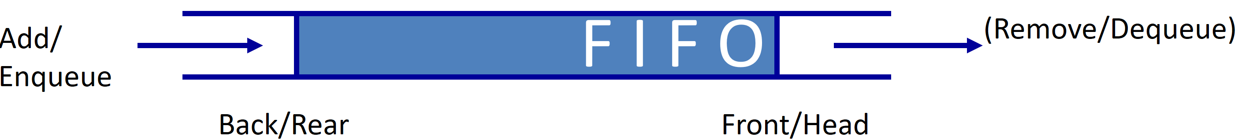
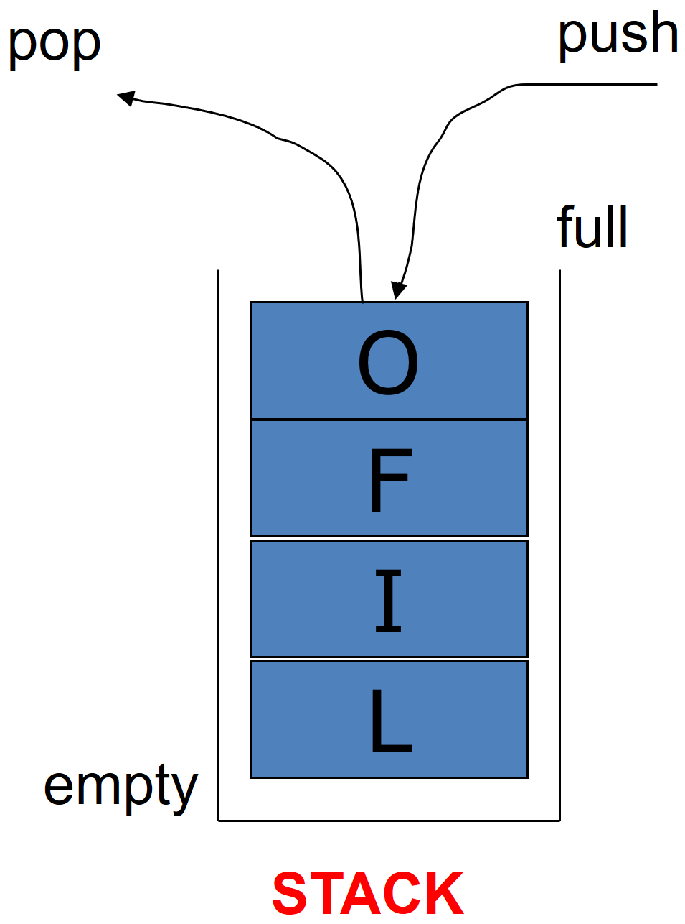
Implementing a Queue: using Array
Using an array to implement a queue is significantly harder than using an array to implement a stack. Why?
A stack: we add and remove at the same end,
A queue: we add to one end and remove from the other.
QUEUE

Slide 178
Implementing a Queue: using Array
There are three options for implementing a queue using an array:
Option 1:
Enqueue at Q[0] and shift all of the rest of the items in the array down to make room.
Dequeue from Q[numItems-1]
Example:
…
Q
0
1
2
numItems-1
maxSize
Q
4
3
10
-1
8
9
numItems=6
0
1
2
3
4
5
Enqueue(Q,-2)
Q
-2
4
3
10
-1
8
9
numItems=7
0
1
2
3
4
5
6
Dequeue(Q)
Q
-2
4
3
10
-1
8
9
numItems=6
0
1
2
3
4
5
6

Slide 179
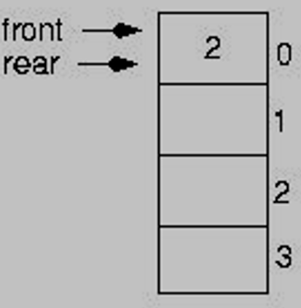
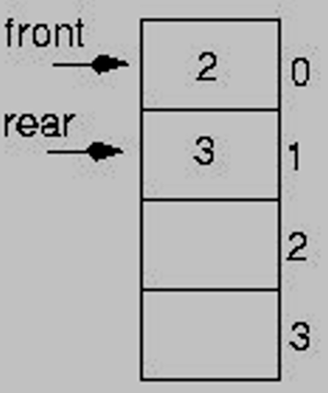
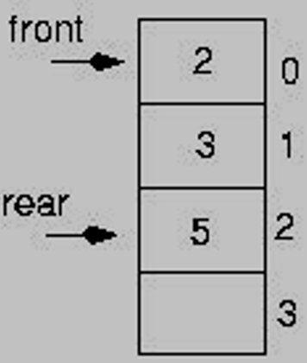
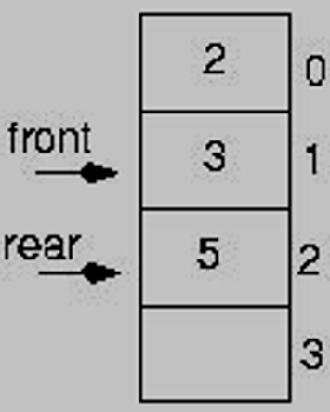
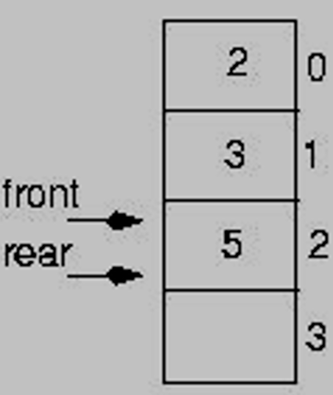
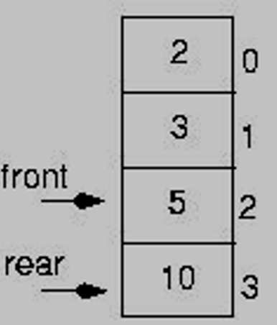
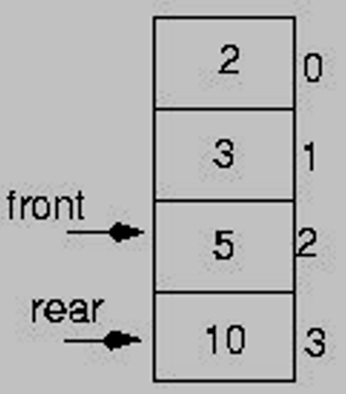
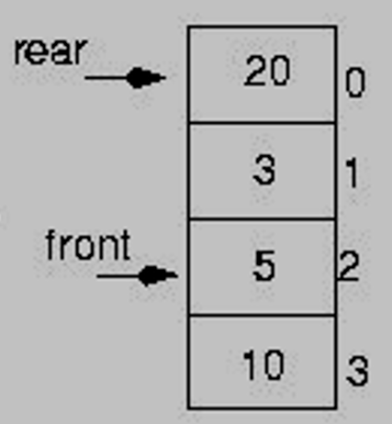
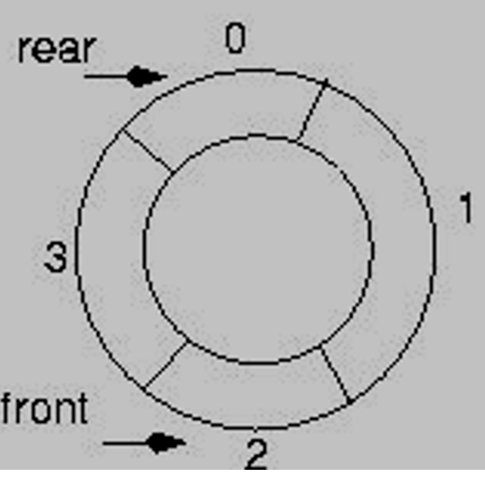
Implementing a Queue: using Array
Q[front]: the first item of the queue
Q[rear]: the last item of the queue
Add item to the Q (Enqueue): rear+=1;Q[rear]=item;
Remove item from Q (Dequeue): remove Q[front]; then front+=1
Option 2: circular queue [“wrap around”]
Example 1: The array used to represent queue has maxSize = 4
initialize: Q is empty: front = 0; rear = -1;
enqueue(Q,2)
enqueue(Q,3)
enqueue(Q,5)
dequeue(Q)
dequeue(Q)
enqueue(Q,10)
rear ++;
Q[rear] = 2;
Q = (2)
rear++;
Q[rear] = 3;
Q = (2, 3)
rear++;
Q[rear] = 5;
Q = (2, 3, 5)
Dequeue Q[front]
Q = (3, 5)
front++;
Dequeue Q[front]
Q = (5)
front++;
rear++;
Q[rear] = 10;
Q = (5,10)
enqueue(Q,20) ???
Let the queue elements
“wrap around”
If (rear == maxSize -1)
rear = 0;
else
rear = rear +1;
rear ++;
Q[rear] = 20;
rear = 4 = maxSize
Array Q over flow
Q = (5,10, 20)
Circular queue
Or
rear = (rear + 1) % maxSize;

Slide 180
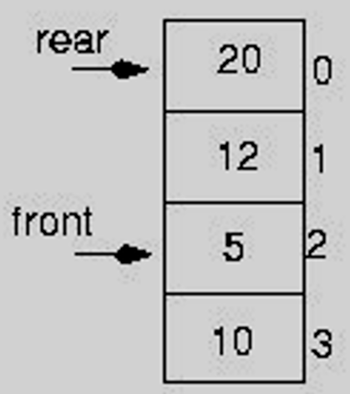
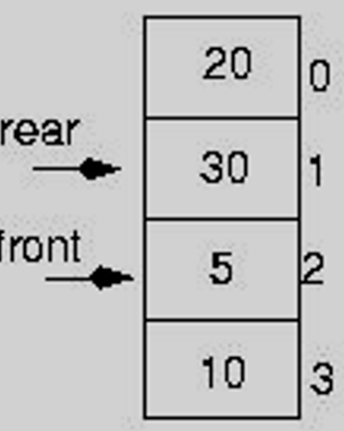
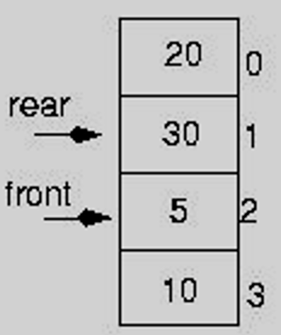




Implementing a Queue: using Array
Q[front]: the first item of the queue
Q[rear]: the last item of the queue
Add item to the Q (Enqueue): rear+=1;Q[rear]=item;
Remove item from Q (Dequeue): remove Q[front]; then front+=1
Option 2: circular queue [“wrap around”]
Example 2: The array used to represent queue has maxSize = 4
Q consists of 3 elements: Q = (5, 10, 20)
enqueue(Q,30)
enqueue(Q,50) ?? When Q is full already
The queue Q is full!!!
What is the condition to determine that the queue is full ?
rear + 1 == front
rear++;
Q[rear] = 30;
Q = (5, 10, 20, 30)
rear++;
Q[rear] = 50;
rear = 2 = front
We can not distinguish between the two cases: EMPTY and FULL !!!!!
dequeue(Q)
dequeue(Q)
dequeue(Q)
dequeue(Q)
The queue Q is empty!!!
What is the condition for an empty queue ?
rear + 1 == front
Dequeue Q[front]
Q = (20, 30)
front++;
=> front = 4=maxSize
=> “wrap around”
front = 0
Dequeue Q[front]
Q = (10, 20, 30)
front++;
Dequeue Q[front]
Q = (30)
front++;
Dequeue Q[front]
Q = empty
front++;

Slide 181
Implementing a Queue: using Array
Option 2: circular queue [“wrap around”]
Solution 1: Make front point to the element preceding the front element in the queue (one memory location will be wasted).
Make front point to the element preceding the front element in the queue (one memory location will be wasted).
Notes:
Make front point to the element preceding the front element in the queue (one memory location will be wasted).

Slide 182






Example 3: illustration for solution 1
Solution 1: Make front point to the element preceding the front element in the queue (one memory location will be wasted).
Make front point to the element preceding the front element in the queue (one memory location will be wasted).
enqueue(Q, 30)
The queue Q is full!!!
What is the condition to determine that the queue is full ?
rear + 1 == front
Q = (10, 20)
Q = (10, 20)
rear++; Q[rear] = 30;
Q = (10, 20, 30)
dequeue(Q)
dequeue(Q)
dequeue(Q)
The queue Q is empty!!!
What is the condition for an empty queue ?
rear == front
Q = (10, 20, 30)
front++;
Dequeue Q[front]
Q = (20, 30)
front++;
front = 4 = maxSize
wrap around: front = 0
Dequeue Q[front]
Q = (30)
front++;
Dequeue Q[front]
Q = empty
Based on this solution 1, one memory location on the array Q is wasted!!!
Notes:
Make front point to the element preceding the front element in the queue (one memory location will be wasted).

Slide 183
Implementing a Queue: using Array
Option 2: circular queue [“wrap around”]
Solution 1: Make front point to the element preceding the front element in the queue (one memory location will be wasted).
Then what are the initial values for front and rear ?
front = rear = maxSize – 1;
Make front point to the element preceding the front element in the queue (one memory location will be wasted).
Q[front+1]: the first item of the queue
Q[rear]: the last item of the queue
Add item to the Q (Enqueue): rear+=1; Q[rear]=item
Remove item from Q (Dequeue): front+=1; then remove Q[front] from queue
Notes:
Make front point to the element preceding the front element in the queue (one memory location will be wasted).

Slide 184








Example 4: The array used to represent queue has maxSize = 4 Initialize: front = rear = maxSize – 1 = 3; Queue Q is empty
illustration for solution 1
Init: front = rear = 3;
enqueue(Q, 2)
dequeue(Q)
enqueue(Q, 3)
enqueue(Q, 5)
rear++;
Q[rear] = 2;
Q= (2)
rear++;
Q[rear] = 3;
Q= (2, 3)
rear++;
Q[rear] = 5;
Q= (2, 3, 5)
front++;
=> front = 4 = maxSize
=> wrap around : front = 0
Dequeue Q[front]
Q= (3, 5)
rear + 1 == front
Queue Q full!!!
dequeue(Q)
enqueue(Q, 10)
enqueue(Q, 20)
In general:
(rear + 1)% maxSize == front
enqueue(Q, 30) ??
ERROR: Queue is full
front++;
dequeue Q[front]
Q= (5)
rear++;
Q[rear] =10;
Q= (5, 10)
rear++;
Q[rear] =20;
Q= (5, 10, 20)

Slide 185




Example 4: The array used to represent queue has maxSize = 4 Initialize: front = rear = maxSize – 1 = 3; Queue Q is empty
illustration for solution 1
dequeue(Q)
dequeue(Q)
dequeue(Q)
Q= (5, 10, 20)
front++;
Dequeue Q[front]
Q= (10, 20)
front++;
Dequeue Q[front]
Q= (20)
front++;
=>front = 4 = maxSize
=> wrap around: front =0
Dequeue Q[front]
Q empty
Queue Q is empty now !!!
rear == front

Slide 186
Implementing a Queue: using Array
Option 2: circular queue [“wrap around”]
Solution 1: Make front point to the element preceding the front element in the queue (one memory location will be wasted).
The initial values for front and rear :
front = rear = maxSize – 1;
Q[front+1]: the first item of the queue
Q[rear]: the last item of the queue
Add item to the Q (Enqueue):
rear+=1; if (rear == maxSize) rear = 0;
Q[rear]=item
Remove item from Q (Dequeue):
front = (front + 1) % maxSize;
then remove Q[front] from queue
Detect queue is empty: rear == front
Detect queue is full: (rear + 1) % maxSize == front
ke front point to the element preceding the front element in the queue (one memory location will be wasted).
Notes:
Make front point to the element preceding the front element in the queue (one memory location will be wasted).

Slide 187
Solution 1: Make front point to the element preceding the front element in the queue (one memory location will be wasted)
init(int max) //initialize empty queue Q
{
maxSize = max;
front = maxSize – 1;
rear = maxSize – 1;
Q = new ItemType[maxSize];
}
int sizeQ(Q) //returns the number of elements currently in the queue Q
{
int size = (maxSize – front + rear) % maxSize;
return size;
}
Q = (5, 10, 20)
Q = (10, 20)
#elements = (4 – 1+ 0) % 4 = 3
#elements = (4 – 2+ 0) % 4 = 2

Slide 188
Solution 1: Make front point to the element preceding the front element in the queue (one memory location will be wasted)
isEmpty(Q) // returns "true“ if queue Q is empty
{
if (rear == front) return true;
else return false;
}
isFull(Q) /*returns "true“ if Q is full, indicates that we already use the maximum memory for queue; otherwise returns “false” */
{
if ((rear + 1) % maxSize == front) return true;
else return false;
}
frontQ(Q) //returns the item that is in front (head) of queue Q or returns error if queue Q is empty.
{
return Q[front + 1];
}

Slide 189
Solution 1: Make front point to the element preceding the front element in the queue (one memory location will be wasted)
enqueue(Q,x) /*inserts item x into the back (rear) of queue Q. If the queue is full before making insertion, then give the notification about that*/
{
if (isFull(Q)) ERROR(“Queue is FULL”);
else
{ rear ++;
if (rear == maxSize) rear = 0;
Q[rear] = x;
}
}
enqueue(Q,x)
{
if (isFull(Q)) ERROR(“Queue is FULL”);
else
{ rear = (rear + 1) % maxSize;
Q[rear] = x;
}
}

Slide 190
Solution 1: Make front point to the element preceding the front element in the queue (one memory location will be wasted)
dequeue(Q) /*deletes the element at the front (head) of the queue Q, then returns x which is the data of this element. If the queue Q is empty before dequeue, then give the error notification*/
{
if (isEmpty(Q)) ERROR(“Queue is EMPTY”);
else
{ front = (front + 1);
if (front == maxSize) front = 0;
return Q[front];
}
}
dequeue(Q)
{ if (isEmpty(Q)) ERROR(“Queue is EMPTY”);
else
{ front = (front + 1) % maxSize;
return Q[front];
}
}
front = front + 1;
=>front = 4 = maxSize
=> wrap around: front =0
Dequeue Q[front]
Q empty
Dequeue (Q)

Slide 191
Implementing a Queue: using Array
Option 2: circular queue [“wrap around”]
Solution 1: Make front point to the element preceding the front element in the queue (one memory location will be wasted).
Solution 2: Make rear point to the element posterior the rear element in the queue (one memory location will be wasted).
Make front point to the element preceding the front element in the queue (one memory location will be wasted).
Notes:
Make front point to the element preceding the front element in the queue (one memory location will be wasted).

Slide 192

Example 5: illustration for solution 2
Solution 2: Make rear point to the element posterior of the rear element in the queue (one memory location will be wasted).
Make front point to the element preceding the front element in the queue (one memory location will be wasted).
enqueue(Q, 30)
?
?
The queue Q is full!!!
What is the condition to determine that the queue is full ?
rear + 1 == front
Q = (10, 20)
Q = (10, 20)
Q[rear] = 30; rear++;
Q = (10, 20, 30)
dequeue(Q)
dequeue(Q)
dequeue(Q)
?
?
?
The queue Q is empty!!!
What is the condition for an empty queue ?
rear == front
front++;
front = 4 = maxSize
wrap around: front = 0
Q = (20, 30)
front++;
Q = (30)
front++;
Q = empty
Based on this solution 2, one memory location on the array Q is wasted!!!
Notes:
Make front point to the element preceding the front element in the queue (one memory location will be wasted).

Slide 193
Implementing a Queue: using Array
Option 2: circular queue [“wrap around”]
Solution 1: Make front point to the element preceding the front element in the queue (one memory location will be wasted).
Then for solution 1: what are the initial values for front and rear ?
front = rear = maxSize – 1;
Solution 2: Make rear point to the element posterior the rear element in the queue (one memory location will be wasted).
Then for solution 2: what are the initial values for front and rear ?
front = rear = 0;
Make front point to the element preceding the front element in the queue (one memory location will be wasted).
Notes:
Make front point to the element preceding the front element in the queue (one memory location will be wasted).

Slide 194




Example 6: The array used to represent queue has maxSize = 4 Initialize: front = rear = 0; Queue Q is empty
illustration for solution 2
Init: front = rear = 0;
enqueue(Q, 2)
dequeue(Q)
enqueue(Q, 3)
enqueue(Q, 5)
?
?
Q[rear] = 2;
rear++;
Q= (2)
Q[rear] = 3;
rear++;
Q= (2, 3)
Q[rear] = 5;
rear++;
Q= (2, 3, 5)
Dequeue Q[front]
front++;
Q= (3, 5)
(rear + 1) % maxSize == front
Queue Q full!!!
dequeue(Q)
enqueue(Q, 10)
enqueue(Q, 20)
?
?
enqueue(Q, 30) ??
ERROR: Queue is full
dequeue Q[front]
front++;
Q= (5)
Q[rear] =10;
rear++;
Q= (5, 10)
Q[rear] =20;
rear++;
Q= (5, 10, 20)

Slide 195


Example 6: The array used to represent queue has maxSize = 4 Initialize: front = rear = 0; Queue Q is empty
illustration for solution 2
dequeue(Q)
dequeue(Q)
dequeue(Q)
?
Q= (5, 10, 20)
Dequeue Q[front]
front++;
Q= (10, 20)
Dequeue Q[front]
front++;
=>front = 4 =maxSize
=> wrap around: front =0
Q= (20)
Dequeue Q[front]
front++;
Q empty
Queue Q is empty now !!!
rear == front

Slide 196
Solution 2: Make rear point to the element posterior the rear element in the queue (one memory location will be wasted)
Exercise: Write following functions for queue Q in the case of Solution 2
isEmpty(Q); returns "true“ if queue Q is empty
isFull(Q); returns "true“ if Q is full, indicates that we already use the maximum memory for queue; otherwise returns “false”
frontQ(Q); returns the item that is in front (head) of queue Q or returns error if queue Q is empty.
enqueue(Q,x); inserts item x into the back (rear) of queue Q. If before making insertion, the queue Q is full, then give the notification about that.
x = dequeue(Q); deletes the element at the front (head) of the queue Q, then returns x which is the data of this element. If the queue Q is empty before dequeue, then give the error notification.
sizeQ(Q); returns the number of elements currently in the queue Q.

Slide 197
Application 1: recognizing palindromes
A palindrome is a string that reads the same forward and backward.
Example: NOON, DEED, RADAR, MADAM
Able was I ere I saw Elba
How to recognize a given string is a palindrome or not:
Step 1: We will put all characters of the string into both a stack and a queue.
Step 2: Compare the contents of the stack and the queue character-by-character to see if they would produce the same string of characters:
If yes: the given string is a palindrome
Otherwise: not palindrome

Slide 198
Example 1: Whether “RADAR” is a palindrome or not
Step 1: Put “RADAR” into Queue and Stack:
front
rear
top

Slide 199
Example 1: Whether “RADAR” is a palindrome or not
Step 2: Delete “RADAR” from Queue and Stack:
Dequeue until the queue is empty
Pop the stack until the stack is empty
Conclusion: String "RADAR" is a palindrome

Slide 200

Example 2: recognizing palindromes
Able was I ere I saw Elba

Slide 201
Application 2: Convert a string of digits into a decimal number
The algorithm is described as following:
// Convert sequence of digits stored in queue Q into decimal number n
// Remove empty space if any
do { dequeue(Q, ch)
} until ( ch != blank)
// ch is now the first digit of the given string
// Calculate n from sequence of digit in the queue
n = 0;
done = false;
do { n = 10 * n + decimal number that ch represents;
if (! isEmpty(Q) )
dequeue(Q,ch)
else
done = true
} until ( done || ch != digit)
// Result: n is the decimal number need to be found

Slide 202
Implementing a Queue
Just like a stack, we can implementing a queue in two ways:
Using an array
Using a linked list

Slide 203
Implementing a Queue: using a linked list
typedef struct {
DataType element;
struct node *next;
} node;
typedef struct {
node *front;
node *rear;
} queue;
where DataType is data type of the object need to store in the queue; DataType need to be declared before declaring the queue.
Implementing a queue using a linked list:
Front of the queue is stored as the head node of the linked list, rear of the queue is stored as the tail node.
Enqueue by adding to the end of the list
Dequeue by removing from the front of the list.
Notes:
--------ppoi ipo m,.,k.jnkm The initial values for front and rear :
front = rear = ., mmaxSize – 1;
Mlpmkllkop .jio ilio’j/0-pp;/l’o9,9oolpo[;p]00l\\\\]

